Slide 1



Brand guide
The rules for every visible part of Orby, for the people and agents who build it. Version 1.1, November 10, 2026.
The PDF beside this file is the reference rendering. This deck names Inter and Inter Tight; install them from docs/brand/fonts for an exact match.
ORBY FOR IPHONE / SUNRISE OPTIMISM
Notes:
Orby brand guide, version 1.1. This deck mirrors docs/brand/brand-guide.md section by section; when they disagree, the guide wins. Headlines are images so they keep the exact Fraunces soft axis on any computer. Orby Brand Guide.pdf is the reference rendering.

Slide 2
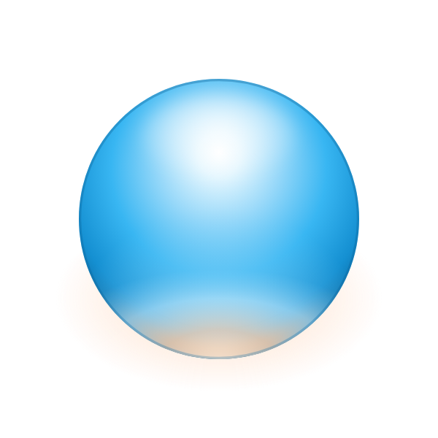




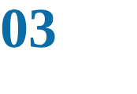

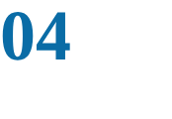
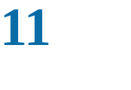
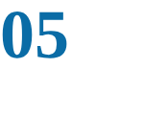
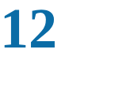

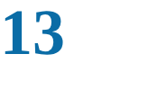
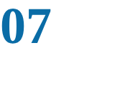
Thirteen sections, one source of truth
CONTENTS
Every rule is checkable: a hex value, a size, a radius, a duration or a do and don't pair.
The idea
Illustration and renders
Logo
Motion and haptics
Color
Voice and copy
Type
Accessibility
Layout and shape
Applying it to the app
Components
The checklist and the brand agent
THE ORB
Iconography
THE MARK AND THE ASSISTANT'S FACE
Notes:
The deck follows the order of brand-guide.md. Builders, people and AI agents, work from these values. When the guide is silent, ask before inventing.

Slide 3



The idea
One good day at a time: a sphere rising over a horizon, lit warm from below.
Notes:
Section 1 of the guide: the idea, why mid-century futurist, the governing image and the three brand words.

Slide 4
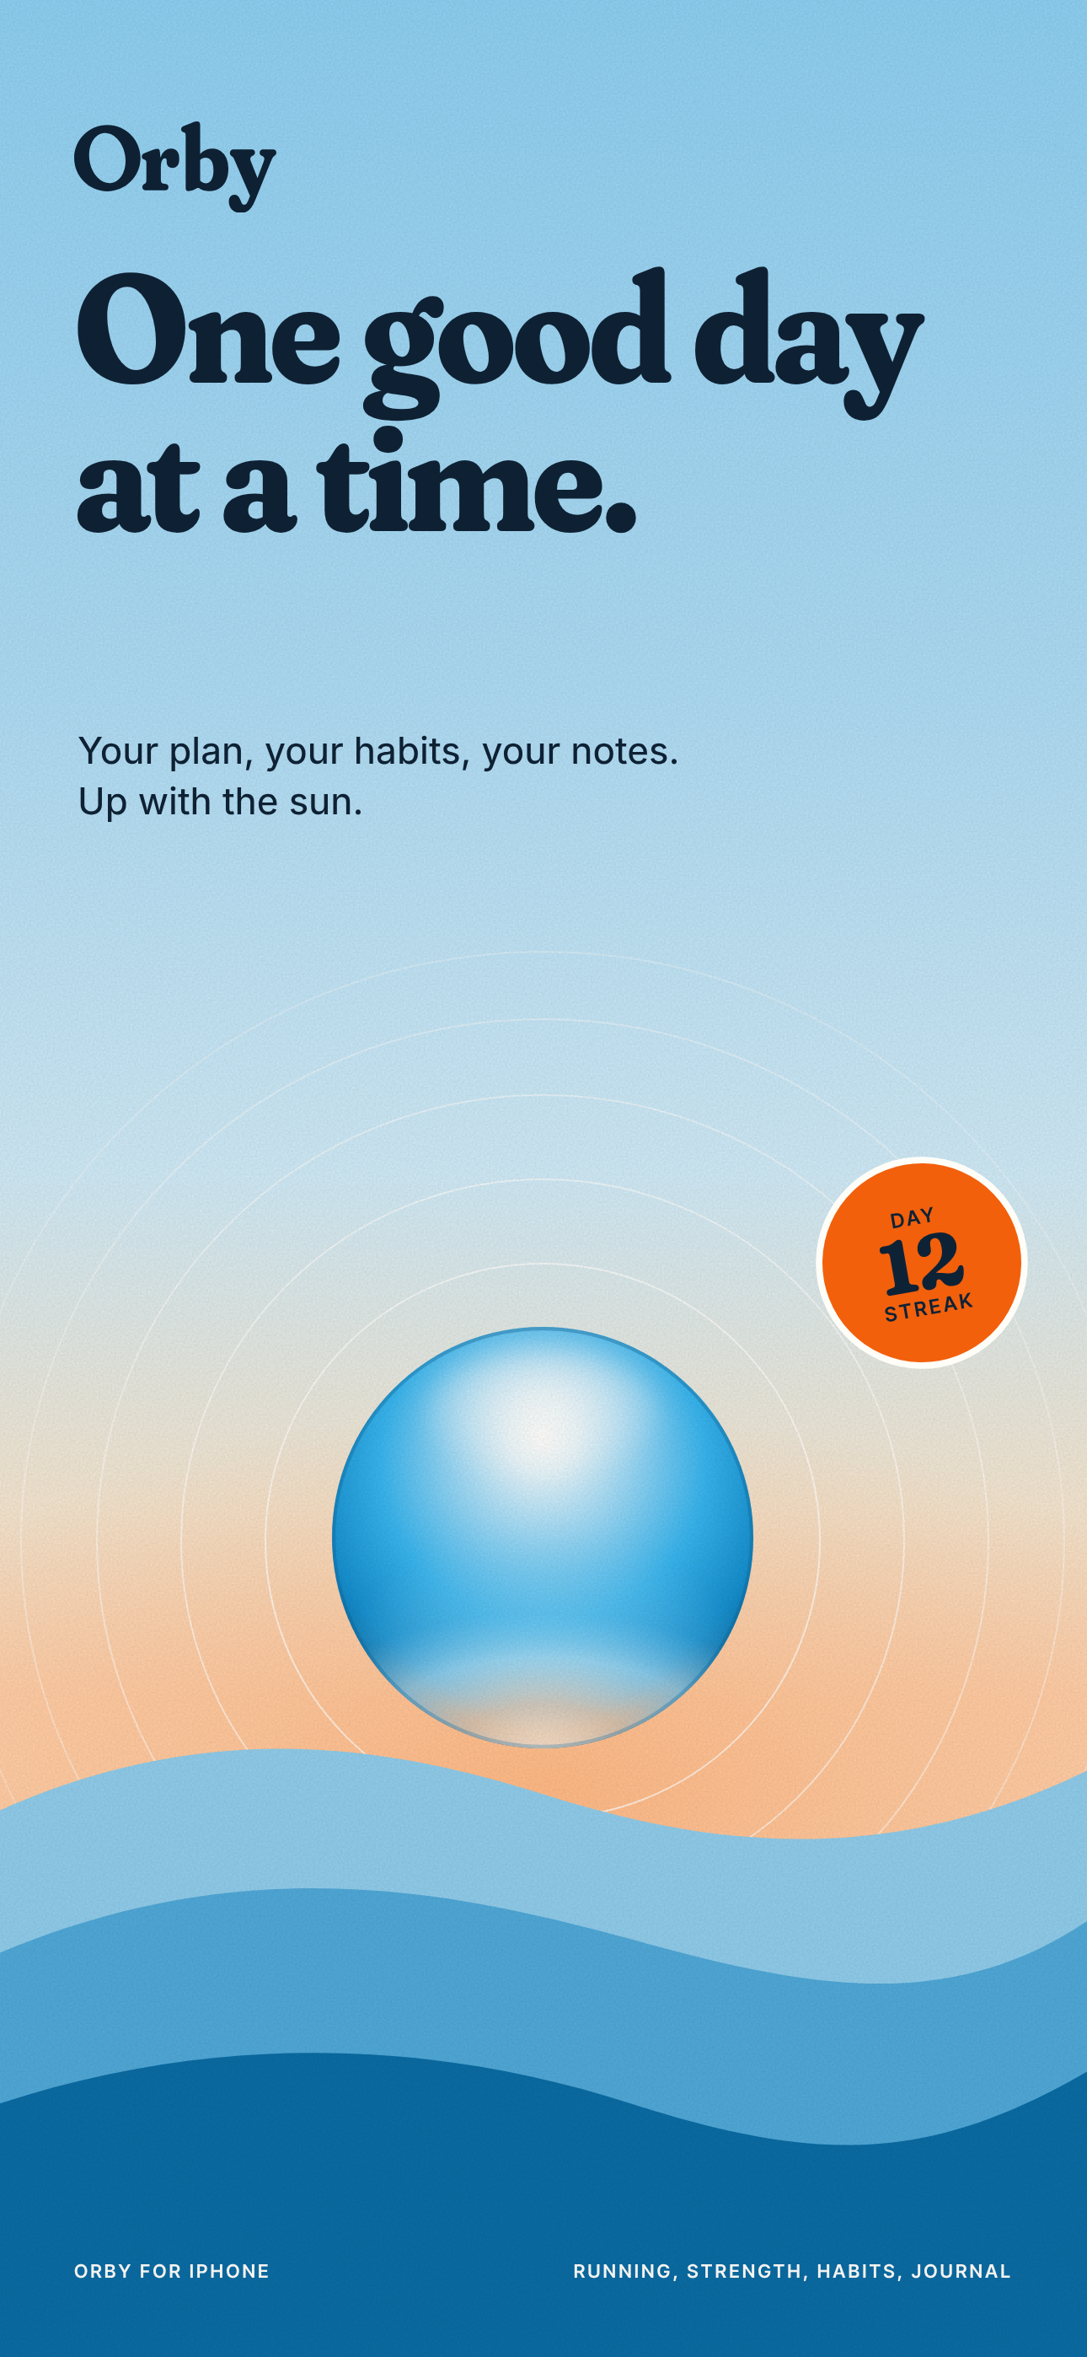




One good day at a time
01 THE IDEA
Every day in Orby starts like a sunrise on a mid-century travel poster.
The sky
The ground. Cloud and Haze, with a dawn wash at the top of every tab.
The sphere
The Orb: the mark and the assistant's face, lit by a sunrise.
The sun's light
Sunrise and Apricot. A now-mark and a glow, never a wall of color.
The horizon
Flat hills, rings and grain on brand art; a half-sun on each tab title.
THREE BRAND WORDS
It assumes today can go well.
One thing at a time, plainly.
Made with care, like a good poster.
Notes:
The governing image is a sphere rising over a horizon, lit warm from below. Sky is the ground, the Orb is the sun, Sunrise orange is the small warm spot that says now, and the poster horizon belongs to brand surfaces.

Slide 5
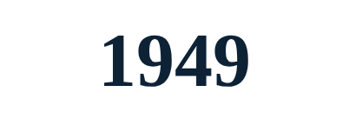
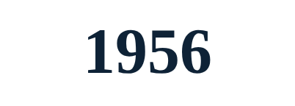
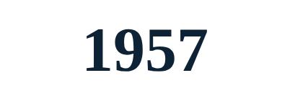
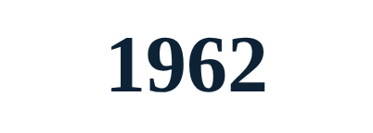


Mid-century futurist, made warm
01 THE IDEA
Reference for the feel: https://www.area.tech/openai. Orby borrows the mood (sky-blue optimism, the circle, mid-century poise) and nothing else.
EAMES
BRAUN
THE SPACE AGE
SAARINEN
EXPO 67 AND 70
THE NASA MANUAL
Flat color fields in a strict grid.
Quiet bodies, one accent control.
The circle and the orbit.
Continuous curves, one warm accent.
Domes and radial forms in public.
Numbers and do and don't pairs.
Starbursts, rockets, atoms, neon, chrome, slate grounds and cockpit density. One sphere is a symbol; five shapes are wallpaper.
WHAT WE LEAVE OUT
Notes:
The reference is cited once, here, as inspiration for mood only. Never use another company's name, mark, wordmark, monogram or artwork in Orby's system, app or marketing.

Slide 6


Logo
The Orb and the wordmark: the name and the mark are one idea.
Notes:
Section 2: the Orb, the wordmark, lockups, clear space, the app icon, the name and misuse.

Slide 7
The Orb: a sky-blue sphere lit by a sunrise
02 LOGO
Blue first. A soft white highlight on top, a warm glow on the lower half, an edge all the way round. Never a band, never two-tone.
BODY | Radial, center 50% / 36%, focus 50% / 26%, radius 64%: #FFFFFF 0, #E4F6FE 12%, #97D8F9 34%, #38B6F2 60%, #1590D2 84%, #0A68A0 100%.
SKY BOUNCE | Radial 50% / 104%, radius 58%: #D6F1FE 95% at 0, #9ADBFA 45% at 50%, 0 at 100%.
UNDERLIGHT | At (50, 99), radius 32, 1.9 x wide. Final opacities #FFE3CB .78 at 0, #FFC9A2 .61 at .34, #DDF3FE .43 at .68, 0 at 1.
WARM GLOW | Bottom crescent mask (shift 5.5) inside r 47.2, #FFD9B8 to #FFB680, blur 2.5, opacity .6.
SPECULAR | Ellipse at (50, 22), 27 x 15, white 70% center fading to 0, blur 2.5.
EDGE | 0.8-unit stroke at r 47.6 all round: #0A5E92 35% top, 30%, 25% bottom.
GLOW | 48 px and up: #FFB680 ellipse at (50, 77), 56 x 32, 50% to 0. Dark grounds 22%, screen.
THE ORB, IDLE, 48 PX AND UP
Notes:
Build the Orb only from the recipe in brand-guide.md 2.1 and tools/orb.mjs (exported as ORB). In the app, render the SVG files; do not repaint them on canvas.

Slide 8
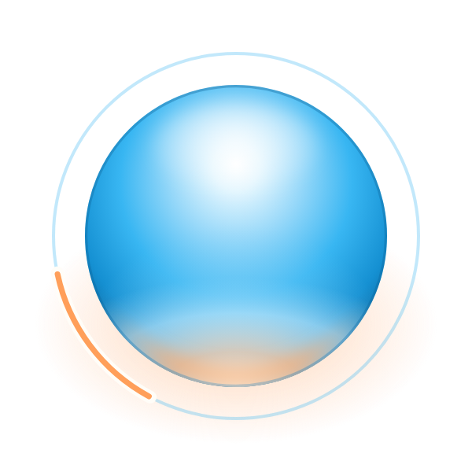
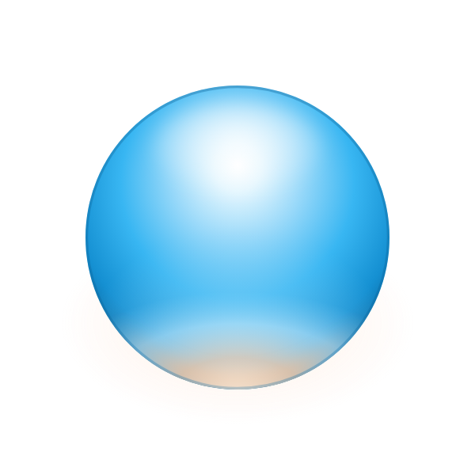

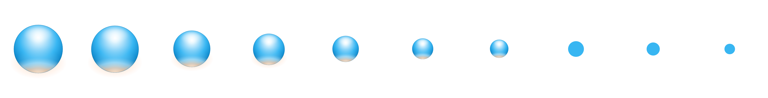
The Orb in use: states and size tiers
02 LOGO
One Orb per screen, and it is the assistant's. Its render follows its measured diameter.
IDLE
THINKING
ON TWILIGHT
FLAT, ONE COLOR
BREATH 1 TO 1.015, 4 S
STATUS LINE CARRIES IT
GLOW 22%, SCREEN BLEND
SKY, NIGHT INK OR PAPER
96 PX
72 PX
56 PX
48 PX
40 PX
32 PX
28 PX
24 PX
20 PX
16 PX
FULL 48 AND UP
GLOSS 28 TO 47
FLAT UNDER 28
Notes:
Idle breathes (48 px and up), thinking warms and orbits (the status line carries the meaning), still is one frame. 48 px and up full, 28 to 47 gloss, under 28 a flat Sky disc. On dark grounds the glow drops to 22% with a screen blend.

Slide 9
The wordmark: Orby in Fraunces, as outlines
02 LOGO
With four letters, the O carries the name. It echoes the Orb in shape and stays a letter, no darker than the rest.
FACE
TRACKING
KERNING
THE O
COLOR
Fraunces 700, SOFT 100, WONK 0, opsz 144. Outlined.
-20 units (-0.01 em). UPM 2000, cap 1400, x-height 890.
O/r -24, r/b +60, b/y +14 units. The r clears the b.
A true circle 1441 u; counter an ellipse 390 x 548 u, tilted 10 degrees.
Night Ink #0E2236 on light, Paper #FFFDF8 on dark. Nothing else.
Notes:
Always use the outlined SVG. Night Ink on light grounds, Paper on dark. The O is a true circle with a lightly tilted elliptical counter: its thickest stroke is 1.05 x the b stem.

Slide 10

Lockups: horizontal and stacked
02 LOGO
Horizontal in headers, with the Orb as a small sun at x-height. Stacked on store art and tall formats.
HORIZONTAL
STACKED
ON DARK GROUNDS
Orb at x-height (900 u) on the baseline. Gap 0.35 C (490 u).
Orb 2 C across, centered on the ink width, 0.5 C above the b.
Paper wordmark, same Orb. Paper on Twilight 9.36.
Notes:
Horizontal: the Orb is x-height (900 units) on the baseline, gap 0.35 C. Where the art already has an Orb, use the wordmark alone. Stacked: Orb 2 C, centered on the ink width, 0.5 C above the b. Under 28 px the lockup Orb is the flat disc.

Slide 11
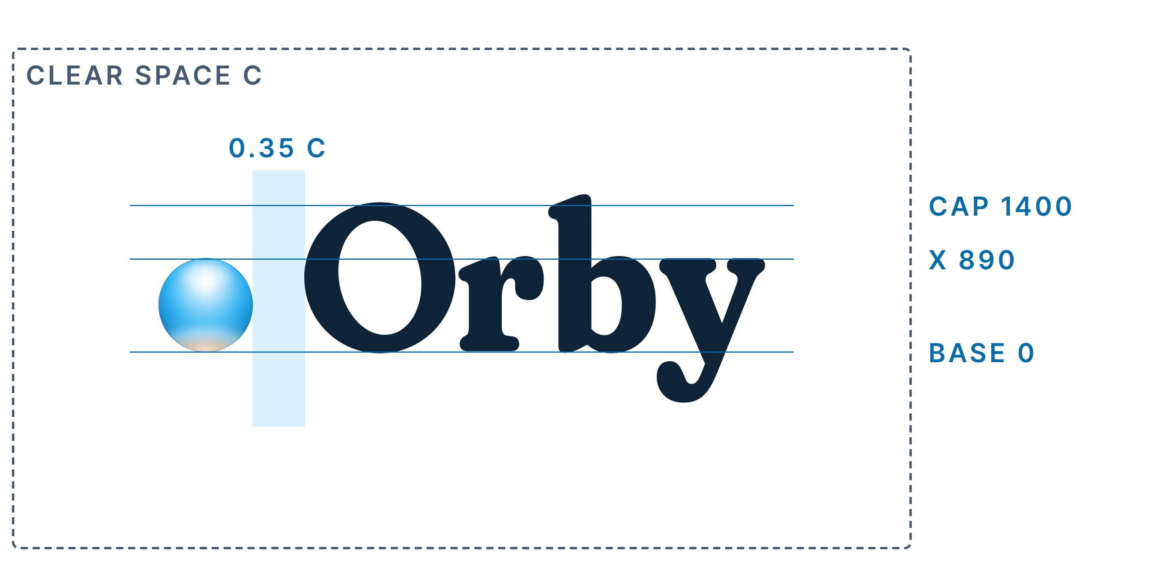
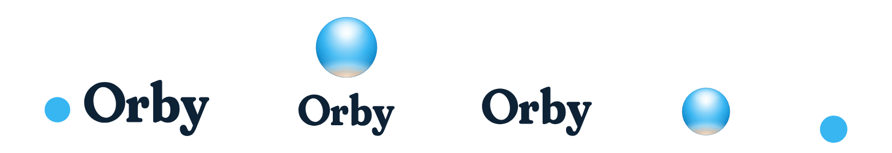
Clear space and minimum size
02 LOGO
Clear space is C, the cap height, on every side. Nothing enters it: no text, no edge, no other mark.
CLEAR SPACE | C on every side of any lockup or the wordmark.
ON SCREEN | Horizontal 96 pt, stacked 56 pt, wordmark 64 pt, gloss Orb 28 pt, flat Orb 16 pt (width).
IN PRINT | Horizontal 25 mm, stacked 15 mm, wordmark 17 mm. Below these, the flat Orb alone.
APP HEADER | The horizontal lockup at 24 pt cap height, its flat-Orb file (the Orb is under 28 px).
96 PT
56 PT
64 PT
28 PT
16 PT
Notes:
Keep C of clear space around any lockup or the wordmark. Below the minimum widths, use the flat Orb alone.

Slide 12
The name is Orby
02 LOGO
The Orb is the mark, so the name and the mark are one idea.
RULE | RIGHT | WRONG
A capital O, the rest lowercase. | Orby | orby, ORBY in running text
Caps only in the caption style. | ORBY FOR IPHONE | Welcome to ORBY
No article, no "app". | Orby plans your week. | the Orby, Orby app
Possessive with 's. | Orby's plan view | Orbys', Orby'
The assistant is "the assistant". | Ask the assistant. | Ask Orby, Orby says
WHAT DOES NOT CHANGE
The repository (LogBook), packages (@logbook/*), the bundle id com.joshbean.logbook, storage keys, the LogbookAPIHost key, code and file names.
EVERYTHING A PERSON SEES
The Home Screen label, index.html title, capacitor.config.ts appName, the manifest, Info.plist text, the splash, onboarding, Settings, disclaimers, emails and share cards.
Notes:
Always Orby with a capital O. Never ORBY in running text, never the Orby or Orby app. Possessive is Orby's. The assistant is still called the assistant. Internal identifiers keep the old name.

Slide 13
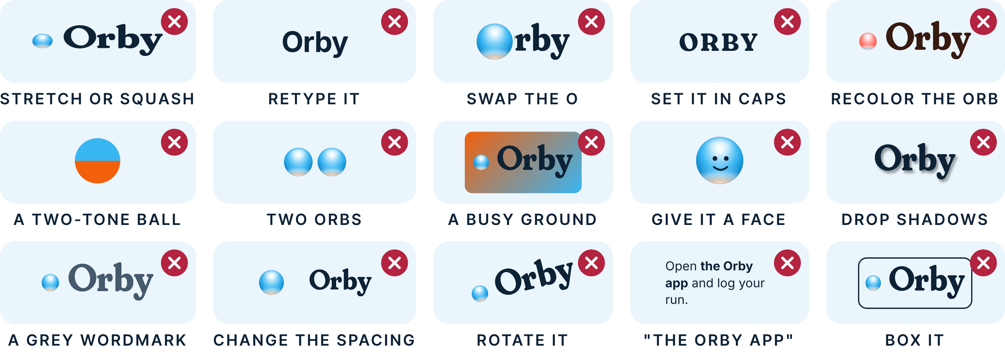
Fifteen ways to break the logo
02 LOGO
Use the files as supplied. Each tile breaks one rule; none of them is ever allowed.
Notes:
Never stretch, retype, swap the O for the Orb, set the name in caps, recolor the Orb, make a two-tone ball, show two Orbs, use a busy ground, give the Orb a face, add shadows, grey the wordmark, change spacing, rotate, say the Orby, or box the logo.

Slide 14


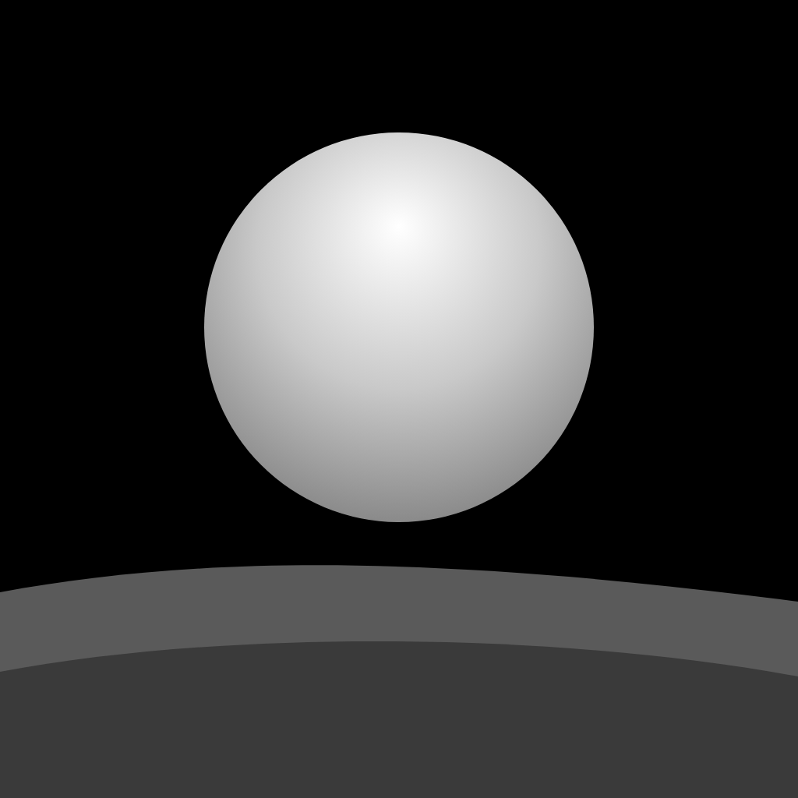
The app icon: a sunrise in a square
02 LOGO
Supply 1024 px, square and opaque. iOS applies the mask. No text: the Home Screen label says Orby.
LIGHT
DARK
TINTED
PALE SKY, THE ORB CLEAR OF THE HILL
NIGHT INK TO TWILIGHT, APRICOT GLOW
GREYSCALE SOURCE, IOS TINTS IT
CANVAS
SKY
ORB
RINGS AND HILLS
DISPLAY NAME
1024 x 1024 px, opaque, no corners, no text.
#CFEBFA 0, #E2F3FC 42%, #F6E7D3 60%, #FFC79C 72%.
500 px (49%) at (512, 420), 0.1 D above the crest.
Rings r 310 and 370, 8 px white. Hills #4FA9DB, #0A6CA6.
Orby. Bundle id stays com.joshbean.logbook.
Notes:
The Orb is 500 px at (512, 420); its bottom clears the hill crest by 0.1 D so its warm lower half always shows. Two 8 px rings. Check at 58 px.

Slide 15


Color
Sky leads. Sunrise means now. Every pairing has a stated ratio.
Notes:
Section 3: the palette, allowed and banned pairings, proportions and orange's exact jobs.

Slide 16












Twelve colors. Sky leads, Sunrise accents
03 COLOR
Two ratios on every swatch: the text that sits on it, and the swatch used as text on Paper (on Twilight where marked), WCAG 2.x.
#38B6F2
#0A6CA6
#CBE8F8
#EAF5FC
#FFFDF8
#F6F0E5
On it: Ink 7.03
On it: White 5.66
On it: Ink 12.64
On it: Ink 14.58
On it: Ink 15.88
On it: Ink 14.23
As text: never (2.26)
As text: 5.57
As text: never
As text: never
On Twilight: 9.36
As text: never
#0E2236
#46596D
#1B4870
#F2600C
#FFB680
#B4430C
On it: White 16.14
On it: White 7.22
On it: White 9.51
On it: Ink 4.96, bold
On it: Ink 9.42
On it: White 5.60
As text: 15.88
As text: 7.10
As text: 9.36
As text: never (3.20)
On Twilight: 5.55
As text: 5.51
Notes:
Sky is a fill and a mark, never text on light grounds. Deep Sky carries blue words. Sunrise means now and stays small. Ember carries the rare orange words. Linen and Twilight never appear in app chrome.

Slide 17
Proportion on every screen
03 COLOR
Share of pixels on any app screen at 390 x 844. A beige screen means Paper crept in where Cloud belongs.
Cloud
Paper
Sky
GROUNDS 65% OR MORE
Cloud, Paper, Haze. The dawn wash counts.
SKY FAMILY 15 TO 25%
Sky, Deep Sky, the Orb.
INK AND DUSK ABOUT 10%
Text.
WARM 5% OR LESS
Apricot glow and Sunrise; Sunrise itself under 2%.
Notes:
Grounds 65 percent or more, the Sky family 15 to 25, text about 10, warm light 5 or less with Sunrise itself under 2 percent. Support colors exist only for a contrast or role need.

Slide 18
Support colors
03 COLOR
Each added for a contrast or role need. Data tones are glyphs, lines and markers, never surfaces.
GRAPHITE
#33475B
Dusk under Increase Contrast. 9.42 on Paper.
DEEP SKY IC
#085A8C
Deep Sky under Increase Contrast; body text on Haze (5.76).
PENCIL
#7A8794, IC #5F6D7B
Marks only, 3.61 on Paper. Rest glyph on Haze: #5F6D7B (4.15).
WARN
#E0A21B, text #7A5A00
Marigold mark with a glyph and words; Warn text 6.28.
SIGNAL
#B42340
Errors and destructive words, 6.35. White on Signal 6.45.
DATA TONES
#117A74 #0A6CA6 #7E3F8F #B23A5B #4A4FB0 #7D6210 #7A8794
Easy, long, hard, fast, lift, cross, rest.
BRAND ART
#8DD0F5 #AEDDF8 #CFEBFA #F4E6D2 #FFD2AE #8FCDEE #4FA9DB #0A6CA6
Sky bands, horizon, three hills.
Notes:
Graphite, Deep Sky IC and Pencil IC are the Increase Contrast steps. Marigold always pairs with a glyph and words. Brand art colors never appear in app chrome.

Slide 19
Text on light grounds: ink and Dusk
03 COLOR
Only listed pairings. Body text needs 4.5:1; large text and graphics need 3:1.
 | TEXT ON GROUND | RATIO | USE
Aa | Night Ink on Paper | 15.88 | Body
Aa | Night Ink on Cloud | 14.58 | Body
Aa | Night Ink on Linen | 14.23 | Body
Aa | Night Ink on Haze | 12.64 | Body
Aa | Night Ink on Apricot | 9.42 | Body
Aa | Night Ink on Sky | 7.03 | Button label, selected day
 | TEXT ON GROUND | RATIO | USE
Aa | Night Ink on Sunrise | 4.96 | Bold 13 px up: the stamp
Aa | Twilight on Paper | 9.36 | Journal pen ink
Aa | Dusk on Paper | 7.10 | Body
Aa | Dusk on Cloud | 6.52 | Body; the splash line
Aa | Dusk on Linen | 6.36 | Body
Aa | Dusk on Haze | 5.65 | Disabled button label
Notes:
Night Ink and Dusk are the text colors. Dusk is the lightest neutral text color. Night Ink on Sunrise is for bold 13 px and up only.

Slide 20
Text on light grounds: blue, orange and status words
03 COLOR
Deep Sky for links, Ember for rare orange words, Warn and Signal for status.
 | TEXT ON GROUND | RATIO | USE
Aa | Deep Sky on Paper | 5.57 | Links
Aa | Deep Sky on Cloud | 5.11 | Body
Aa | Deep Sky on Linen | 4.99 | Body
Aa | Deep Sky on Haze | 4.43 | Large only
Aa | #085A8C on Haze | 5.76 | Body on Haze
Aa | Ember on Paper | 5.51 | Today tag, streak label
 | TEXT ON GROUND | RATIO | USE
Aa | Ember on Cloud | 5.06 | Body
Aa | Ember on Linen | 4.94 | Body
Aa | Warn text on Paper | 6.28 | On Warn soft 5.63
Aa | Signal on Paper | 6.35 | On Signal soft 5.27
Aa | White on Signal | 6.45 | Destructive action fill
Aa | White on Deep Sky | 5.66 | Caption on the hills
Notes:
Deep Sky on Haze is large text only; use #085A8C for body there. Ember never sits on Haze. White on Signal is allowed for a destructive action fill.

Slide 21
Text on dark grounds
03 COLOR
Dark grounds are for brand surfaces: the night splash, the dark icon, section slides, share cards.
 | TEXT ON GROUND | RATIO | USE
Aa | White on Night Ink | 16.14 | Toasts, dark slides
Aa | White on Twilight | 9.51 | Body
Aa | White on Dusk | 7.22 | Body
Aa | White on Ember | 5.60 | Body
Aa | Paper on Twilight | 9.36 | Wordmark, text on dark
 | TEXT ON GROUND | RATIO | USE
Aa | Paper on Night Ink | 15.88 | Wordmark on Night Ink
Aa | Haze on Twilight | 7.45 | Secondary text on dark
Aa | Apricot on Twilight | 5.55 | Warm accent text
Aa | Sky on Twilight | 4.14 | Large text, graphics only
Aa | Night Ink on poster sky | 9.59 | Hero headline on brand art
Notes:
Paper, Haze and Apricot carry text on Twilight and Night Ink. Sky on Twilight is large text and graphics only.

Slide 22
Banned pairings and decorative marks
03 COLOR
The banned list is checked on every change. A mark under 3:1 must be decorative: the meaning lives elsewhere.
 | TEXT ON GROUND | RATIO | INSTEAD
Aa | Sky text on Paper | 2.26 | Sky is a fill
Aa | White on Sky | 2.30 | Night Ink on Sky
Aa | White on Sunrise | 3.25 | Night Ink, bold
Aa | Sunrise text on Paper | 3.20 | Words are Ember
Aa | Dusk on Sky | 3.14 | Night Ink
 | TEXT ON GROUND | RATIO | INSTEAD
Aa | Ember on Haze | 4.38 | Tag on Paper
Aa | Night Ink on Twilight | 1.70 | Paper on Twilight
Aa | Sunrise touching Sky | 1.42 | 2 px Paper keyline
Aa | Pencil glyph on Haze | 2.87 | #5F6D7B (4.15)
DECORATIVE BY DESIGN
Minor gauge ticks (1.57; the readout carries the value), the off coin ring (1.80; the check carries it), the off chip edge (1.44; the label carries it), the thinking arc (2.0; the status line carries it). Journal discs carry a numeral, never lightness alone.
Notes:
Never white on Sky or Sunrise, never Sky or Sunrise as text on light grounds, always a Paper keyline where Sunrise touches Sky. Night Ink on Twilight is 1.70.

Slide 23
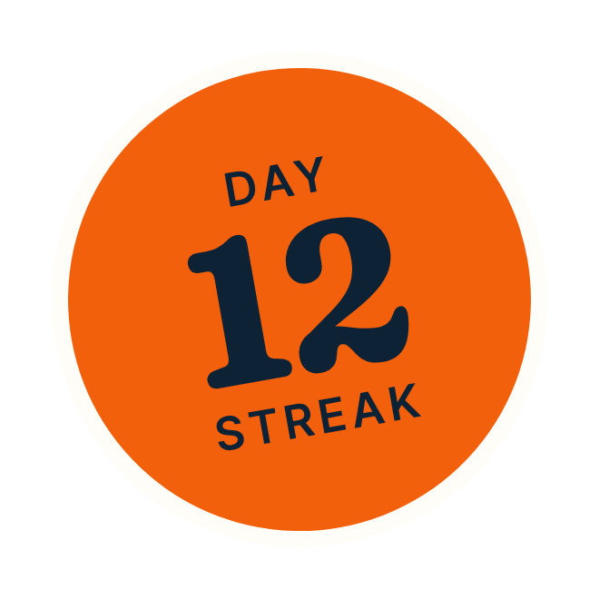
Sunrise means now. It has six jobs
03 COLOR
At most three on a screen. When more would show, the lower priority yields to Night Ink.
T
10
TODAY'S DOT
GAUGE POINTER
BADGE DOT
MILESTONE STAMP
LIVE NODE
NOW ON A CHART
6 px above today's letter, 2 px keyline.
12 px dot, 3.5 px Paper keyline.
8 px, 2 px keyline. Yields first.
One per screen. Ink on Sunrise 4.96.
12 px on a timeline, 2 px keyline.
The 8 px now dot and the NOW tick.
PRIORITY
1 Today's dot 2 Gauge pointer (Progress: NOW tick and now dot) 3 Live node 4 Stamp 5 Badge dots. Past the third, a mark turns Night Ink. Ember words, Apricot light and the thinking arc do not count.
Notes:
Priority: today's dot, then the gauge pointer (or the NOW tick and now dot on Progress), the live node, the stamp, badge dots. A yielding mark keeps its shape and turns Night Ink. Keylines at least 2 px; the pointer 3.5; the stamp max(2px, 3.3%).

Slide 24


Type
Fraunces for display, Inter for everything people read and every live number, Inter Tight for captions.
Notes:
Section 4: families and licenses, the scale, captions and numerals.

Slide 25
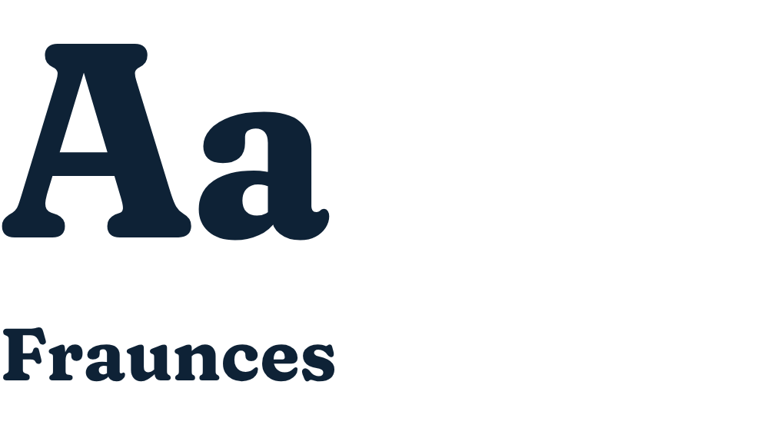
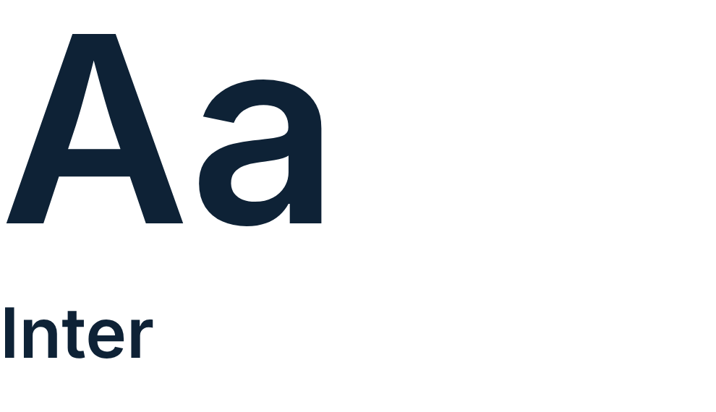
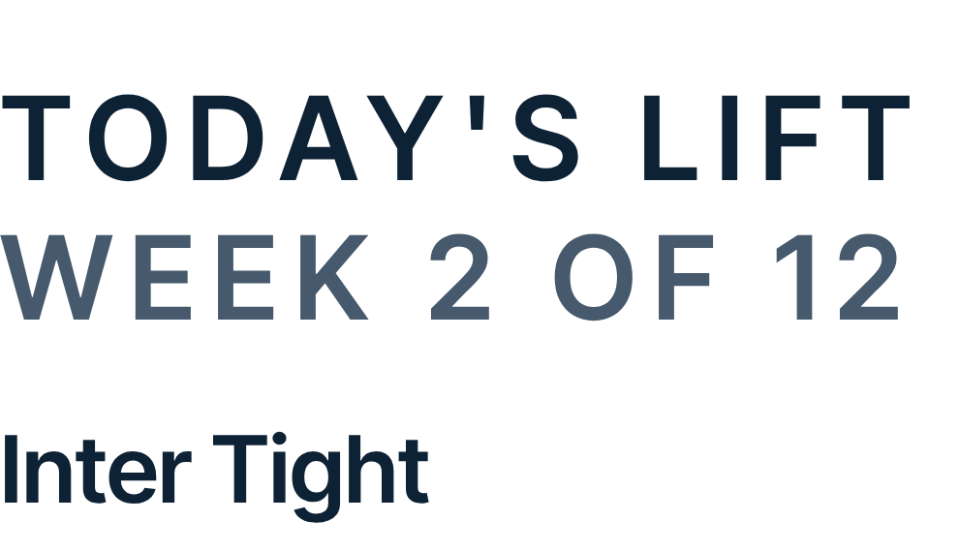
Three families, all SIL OFL
04 TYPE
All licensed for a shipped app, self-hosted from docs/brand/fonts.
Titles, card titles, the session name, static hero stats. Italic 420 is the sentence voice. Roman 600 to 700.
Body, buttons, tabs, chips, inputs and every number that changes, with tabular-nums.
Captions only: 600, caps, +0.14 em, 11 px floor. And gauge end labels.
SIL OFL 1.1
SIL OFL 1.1
SIL OFL 1.1
fraunces-latin-full (SOFT and WONK)
inter-latin-wght
inter-tight-latin-wght
Notes:
Fraunces replaces Instrument Serif. The html rule sets SOFT 100 and WONK 0 once; nothing else sets font-variation-settings. Inter Tight faces become font-weight 100 900 so a 600 caption gets the 600 instance.

Slide 26
The type scale: display
04 TYPE
Sizes in rem at a 16 px root, so iOS Larger Text scales them. At most 4 Fraunces sizes on one screen.
ROLE | FACE | SIZE / LINE | WEIGHT | COLOR | TOKEN
Hero | Fraunces | 3.5 / 3.5 rem (56/56) | 700, -0.02 em | Night Ink | --fs-hero
Screen title | Fraunces | 2.375 / 2.625 rem (38/42) | 650, -0.015 em | Night Ink | --fs-title
Session name | Fraunces | 2.5 / 2.625 rem (40/42) | 650, -0.015 em | Night Ink | --fs-stamp
Static hero stat | Fraunces | 2.75 to 3.625 rem, line 1 | 650 | Night Ink | --fs-stat
Section title | Fraunces | 1.625 / 2 rem (26/32) | 600 | Night Ink | --fs-section
Card, sheet title | Fraunces | 1.375 / 1.75 rem (22/28) | 600 | Night Ink | --fs-head
Sentence | Fraunces italic | 1.375 / 1.75 rem (22/28) | 420 | Night Ink | --fs-sentence
Sentence, small | Fraunces italic | 1.0625 / 1.375 rem (17/22) | 420 | Dusk | --fs-sentence-sm
Notes:
Fraunces roman never under 600 or 20 px; italic 420, never under 17 px. Fraunces has no tabular figures, so it never sets a number that changes.

Slide 27
The type scale: UI and numbers
04 TYPE
Inter for everything a person reads or taps, and every live number. At most 5 Inter sizes on one screen.
ROLE | FACE | SIZE / LINE | WEIGHT | COLOR | TOKEN
Live hero stat | Inter | 2.75 rem, line 1, tnum | 650, -0.02 em | Night Ink | --fs-stat-live
Row headline | Inter | 1.0625 / 1.375 rem (17/22) | 600 | Night Ink | --fs-row
Body | Inter | 1 / 1.5 rem (16/24) | 400 | Night Ink | --fs-body
Secondary | Inter | 0.9375 / 1.25 rem (15/20) | 500 | Dusk | --fs-sub
Habit tile name | Inter | 0.9375 / 1.125 rem (15/18) | 600 | Night Ink | --fs-tile
Footnote, tag | Inter | max(13px, 0.8125rem) | 500; tag 600 | Dusk; Ember | --fs-foot, --fs-tag
Small tile label | Inter | max(12px, 0.75rem) | 600 | Night Ink | --fs-orb
Tab label | Inter | max(11px, 0.6875rem) | 550; 650 active | Dusk; Ink | --fs-caps
Caption | Inter Tight | max(11px, 0.6875rem) | 600, caps, +0.14 em | Ink or Dusk | --fs-caps, --tr-caps
Notes:
Small roles carry px floors (11, 12, 13). Raw px font sizes fail check-styles.mjs; off-scale rem sizes fail check-brand.mjs.

Slide 28
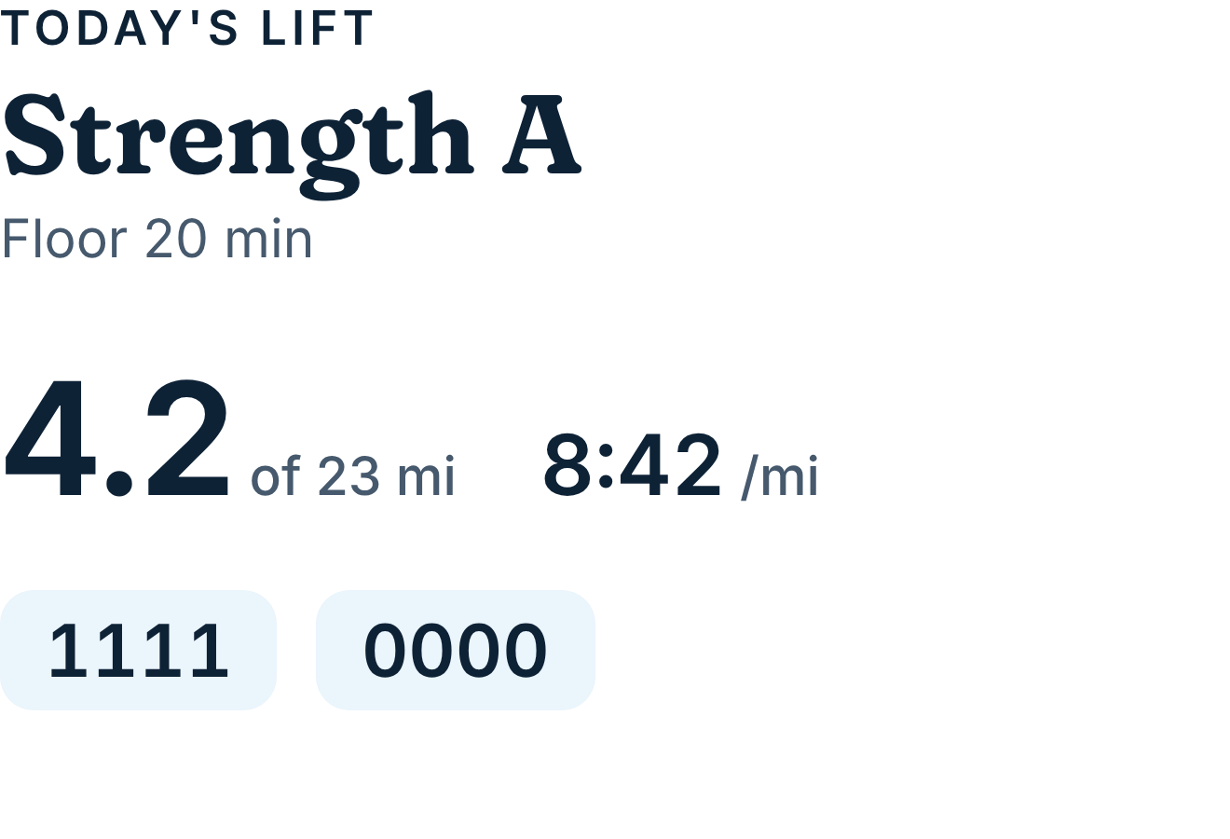
Captions, numerals and type rules
04 TYPE
Live numbers are Inter with tabular figures. Captions are tiny, letterspaced and few.
DO | DON'T
Fraunces for titles, sentences and static stats. | Fraunces in buttons, chips, inputs, coins or live numbers.
Inter 650 tnum for a stat that changes. | tabular-nums on Fraunces (it has no tabular figures).
Fraunces roman at 600 to 700. | Fraunces roman under 600.
Fraunces at 17 px and up (italic), 20 px and up (roman). | Fraunces below those floors.
Captions: one per card, 4 words, no period. | A second caps tracking, or caps as the only label.
rem sizes with px floors. | Raw px font sizes.
Times "6:30", distances "4.2 mi", durations "45 min" and "2 h 4 min". No leading zeros on hours.
Notes:
Captions: Inter Tight 600, 11 px floor, caps, +0.14 em, one per card, four words at most. Every live number is Inter with tabular-nums: 1111 and 0000 render at the same width. Fraunces sets only static numbers.

Slide 29


Layout and shape
A 16 px gutter, eight spacing steps, six radii and one soft shadow.
Notes:
Section 5: grid, spacing, radii, surfaces and dividers.

Slide 30
Spacing steps and radii
05 LAYOUT AND SHAPE
Eight spacing steps plus three named exceptions. Six radii. Nothing else.
4
8
12
16
20
24
32
48
R 24 ON 96
R 18 ON 96
R 14 ON 96
SPACING STEPS, PX (16 IS THE GUTTER)
CARDS, SHEETS
TILES, CHIPS
INPUTS, MENUS
GUTTER | 16 px at every phone width.
GAPS | Cards 12, habit tiles 12, sections 32, header to card 12.
PADDING | Card 16, hero card 20, habit tile 12. Hit 44 x 44 pt.
EXCEPTIONS | Week-dot gap 3, today dot offset -7, dock fade 52.
R 12 ON 96
PILL
CIRCLE
ICON TILES
BUTTONS, BARS
COINS, DOTS
Notes:
Spacing: 4, 8, 12, 16, 20, 24, 32, 48 for padding, margin and gap; the only exceptions are --gap-dot 3, --dot-offset -7 and --fade-h 52. Habit tiles gap and pad 12. Radii are drawn here at true ratio on a 96 px box.

Slide 31


Components
Every part has a token or a number to check.
Notes:
Section 6: the dock, buttons, chips, cards, the gauge, habit tiles, the week strip, charts, sheets, toasts, empty states, the assistant, Today's other parts, primitives and third-party marks.

Slide 32
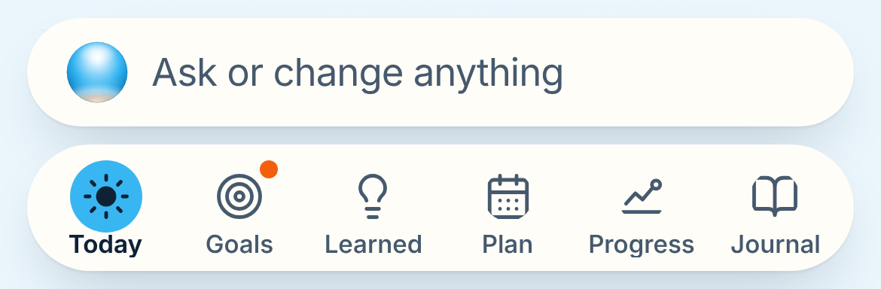
The floating dock and tab capsule
06 COMPONENTS
The ask bar and six tabs float together, 8 px above the safe area, on a Cloud fade.
POSITION | 12 px in from each edge, 8 above the safe area, a 52 px Cloud fade.
ASK BAR | 48 tall, Paper pill, Orb 28 px still. "Ask or change anything" Inter 17 Dusk.
CAPSULE | 56 tall, Paper pill, six tabs in order.
TAB | Icon 22 px, 1.75 stroke, in a 32 px circle. Label Inter 11 550 Dusk.
ACTIVE | 32 px Sky disc, Night Ink icon (7.03), label 650.
BADGE | 8 px Sunrise dot, 2 px Paper keyline.
FOLD | The Orb becomes a 48 px round button holding a 28 px Orb.
ASK BAR 48, CAPSULE 56, GAP 8
Notes:
Tabs: Today, Goals, Learned, Plan, Progress, Journal. The active tab is a 32 px Sky disc with a Night Ink icon. The ask bar Orb is 28 px gloss and still. Progress uses the set's rising-line glyph.

Slide 33
Buttons
06 COMPONENTS
Night Ink words on Sky. One primary per screen. Orange is never a button.
Set today's goal
PRIMARY | Sky #38B6F2, Night Ink Inter 17 650 (7.03). 54 full width, 44 inline. Pressed scale 0.97, 160 ms, #5CC4F5. Disabled Haze, Dusk (5.65).
SECONDARY | Paper, Night Ink 600, 1 px --edge, no shadow.
QUIET | Deep Sky Inter 600 (5.57), 44 hit. Also "+ Set".
DESTRUCTIVE | Paper, Signal 600 (6.35), 1 px edge. Confirm in a sheet.
ROUND ICON | 40 px Paper circle (44 hit), 18 px icon, --shadow-float.
PRIMARY
Write today's entry
SECONDARY
History >
QUIET
Delete plan
DESTRUCTIVE
Save
DISABLED
DO | DON'T
Night Ink words on Sky. | White words on Sky (2.30).
One primary per screen. | Two Sky buttons competing.
+
ROUND ICON
Notes:
The primary is Sky with a Night Ink label at 7.03; white on Sky fails at 2.30. Secondary is Paper with a 1 px --edge. Destructive words are Signal and confirm in a sheet.

Slide 34
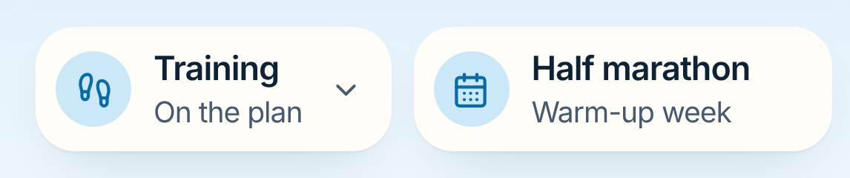
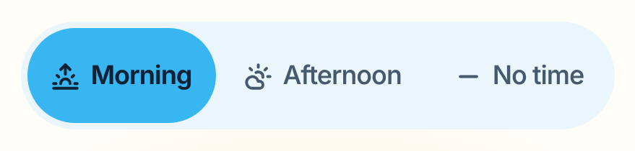
Chips, tags and segmented controls
06 COMPONENTS
Selected things are Sky with Night Ink words. Tracks are Cloud. Tags stay small.
CONTEXT CHIP | Paper, r 18, --shadow-1, padding 12. 40 px Haze circle, Deep Sky 18 px glyph. Title Inter 17 600, subtitle 15 Dusk.
FILTER CHIP | Pill, 32 tall (44 hit). Off: Paper, 1 px --line-strong, Dusk. On: Sky, Night Ink 650.
TAG | Pill, 28 tall, Inter --fs-tag 600. Today: Ember on Paper, 1 px Ember keyline at 40%. Planned: Dusk on Cloud.
SEGMENTED | Cloud track, Sky thumb, Inter 15. 44 tall in a card, 36 in a bar. Thumb on springs.settle.
Today
Planned
Easy
Long
TAGS
FILTER CHIPS: OFF, ON
Notes:
Context chips are Paper with a 40 px Haze disc. Filter chips and the segmented thumb turn Sky when on. The Today tag is Ember on Paper, never on Haze (4.38 fails).

Slide 35
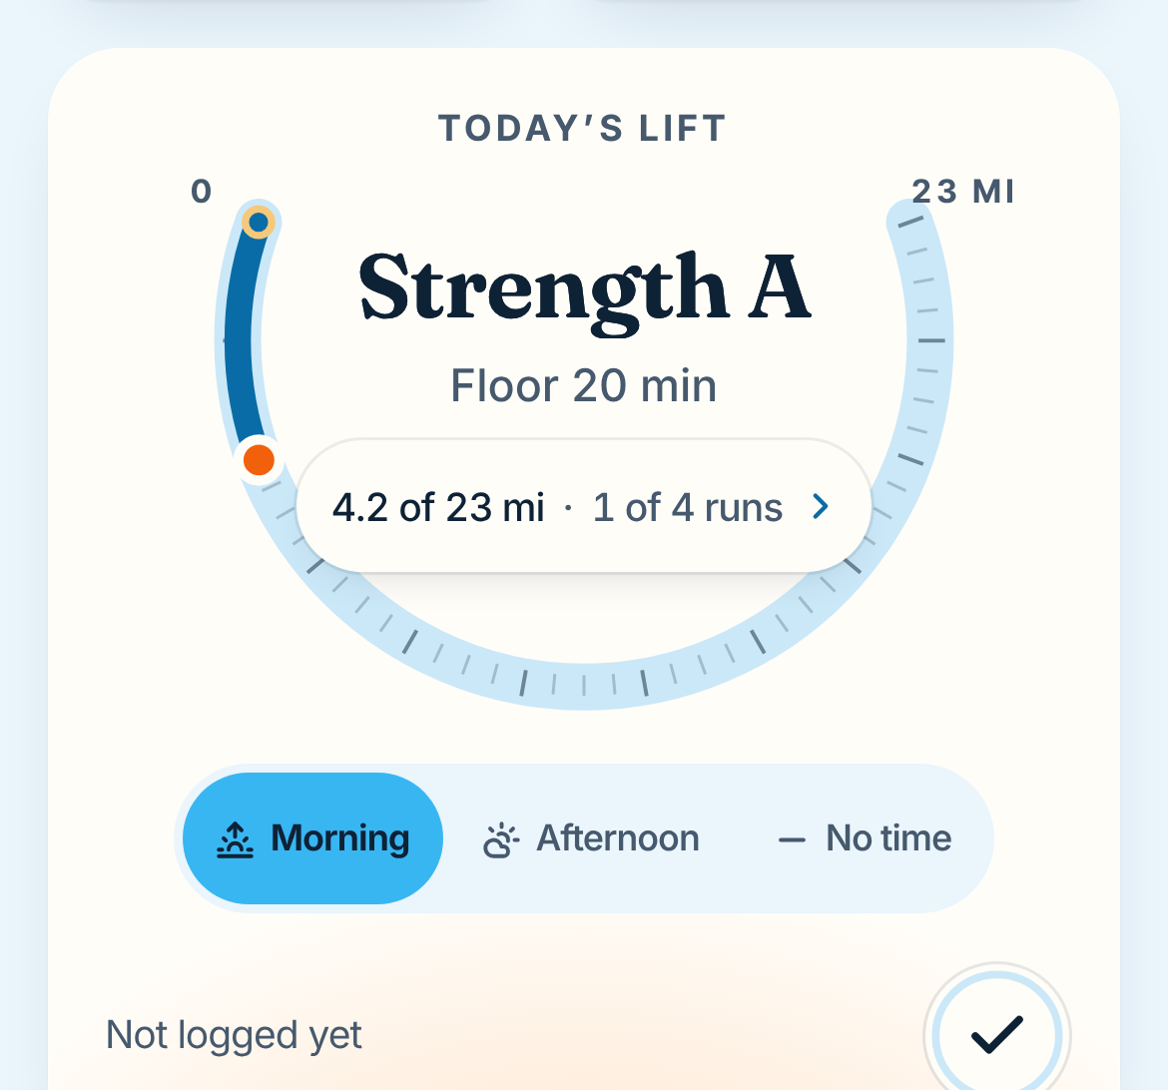
Cards and the hero card
06 COMPONENTS
Paper cards on a Cloud ground, no borders. One hero card per screen, with the only sunrise glow.
CARD | Paper #FFFDF8, r 24, padding 16, no border. One caption, one primary at most.
SHADOW-1 | 0 1px 1px rgba(14,34,54,.04), 0 10px 28px -14px rgba(14,34,54,.20).
HERO CARD | One per screen. Padding 20. The sunrise glow under its bottom edge.
SUNRISE GLOW | radial-gradient(closest-side, rgba(255,182,128,.42), transparent), -12% sides, -52% bottom, 78% tall.
ICON TILE | 32 px, r 12, Haze, Deep Sky glyph. Session tiles 48 px, the data tone.
GROUND | Cloud with the dawn wash on tab roots; it scrolls with the page.
Notes:
A card is Paper, radius 24, padding 16, --shadow-1. The hero card holds the screen's main thing and carries the one glow.

Slide 36
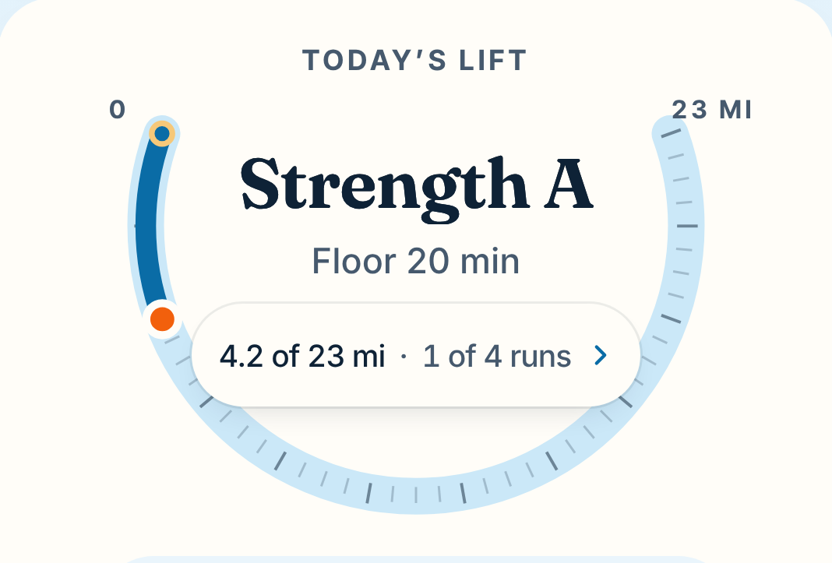
The U-arc training gauge, Today's hero
06 COMPONENTS
A Haze track, a Deep Sky fill, a Sunrise pointer, horizontal end labels and a readout inside the bowl.
GEOMETRY | 220 degrees, center (150, 62), r 118, viewBox 300 x 200. SVG y-down: 200 degrees (39.1, 21.6) through 90 to -20 (260.9, 21.6).
TRACK, FILL | Track 16 px Haze. Fill 9 px Deep Sky to the pointer, a Deep Sky start cap.
TICKS | On the outer edge. Minor 0.5 mi, 1 x 5, --tick; major 5 mi, 1.5 x 10, --tick-major.
POINTER | 12 px Sunrise, 3.5 px Paper keyline.
END LABELS | "0" and "23 MI", caption style, Dusk, tnum, horizontal.
READOUT | Paper pill, --shadow-pill, Inter 17 tnum: "4.2 of 23 mi · 1 of 4 runs". 8 px clear of the track.
MOTION | Fill springs.number (stroke-dashoffset), pointer springs.settle. First view only.
READOUT: REQUIRED ON EVERY GAUGE
Notes:
The fill is Deep Sky (4.43 on Haze), never Sky (1.80). The readout carries the number; it sits inside the bowl, clear of the track. The fill sweeps on springs.number, the pointer on springs.settle.

Slide 37
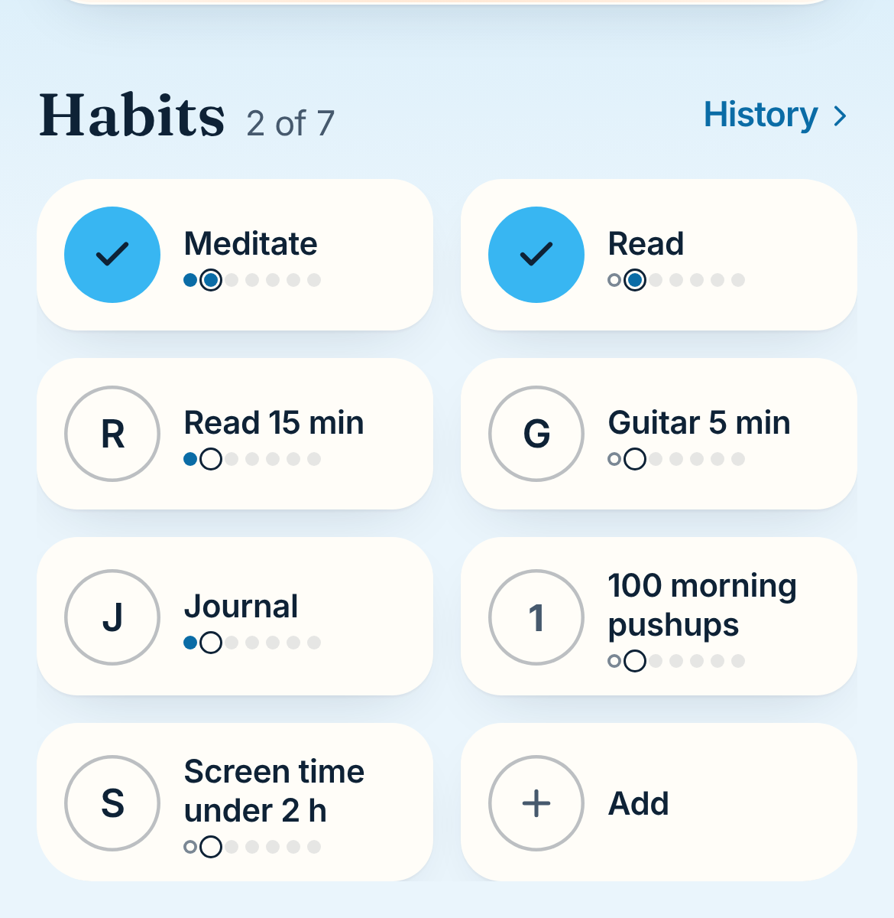
Habit tiles
06 COMPONENTS
Two columns of Paper tiles. A lit coin is a flat Sky disc with a Night Ink check, never a glossy Orb.
GRID | Two columns, gap 12. Tiles Paper, r 18, --shadow-1, min 60, padding 12.
COIN, OFF | 42 px, 1.5 px --coin-ring (decorative), initial Inter 600 --fs-row.
COIN, LIT | Flat Sky disc, Night Ink check (7.03). Overshoot to 1.12, orb haptic.
NAME | Inter 600 --fs-tile, sentence case: "Read 15 min". Up to 2 lines.
WEEK DOTS | 6 px, gap 3. Done Deep Sky; missed 1.25 px Pencil ring; ahead --dot-ahead; shown day an Ink outline.
ADD TILE | 42 px circle, 1.5 px --line ring and +, "Add" Inter 600.
Notes:
Initials are Inter 600, names sentence case. Lit coins overshoot to 1.12 on springs.complete with the orb haptic on the peak. Week dots never use orange.

Slide 38
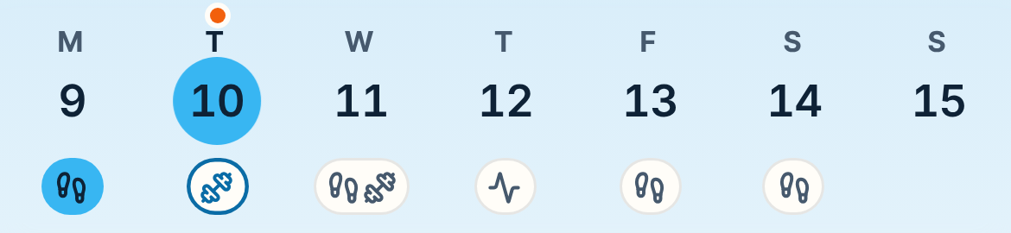
The week strip
06 COMPONENTS
Today and the shown day are never the same signal: today keeps its Sunrise dot, the shown day gets the Sky disc.
LETTER | Caption style, Dusk. Today's letter Night Ink.
NUMERAL | Inter 600 1.0625 rem, Night Ink, tnum.
SHOWN DAY | 34 px Sky disc (7.03), on springs.settle.
TODAY | 6 px Sunrise dot, 2 px keyline, 7 px above the letter. Always.
KIND PILL | 22 tall. Paper, 1 px edge. Done Sky, Ink glyphs. Today planned: Deep Sky ring.
HIT | Each cell 44 pt wide or more, 81 tall.
TODAY
SHOWN DAY
T
F
10
13
DOT PLUS A NIGHT INK LETTER
SKY DISC PLUS A NUMERAL
Notes:
Seven cells, Monday first, sticky under the title bar on --wash-strip. Today always keeps its dot, whether or not it is the shown day.

Slide 39
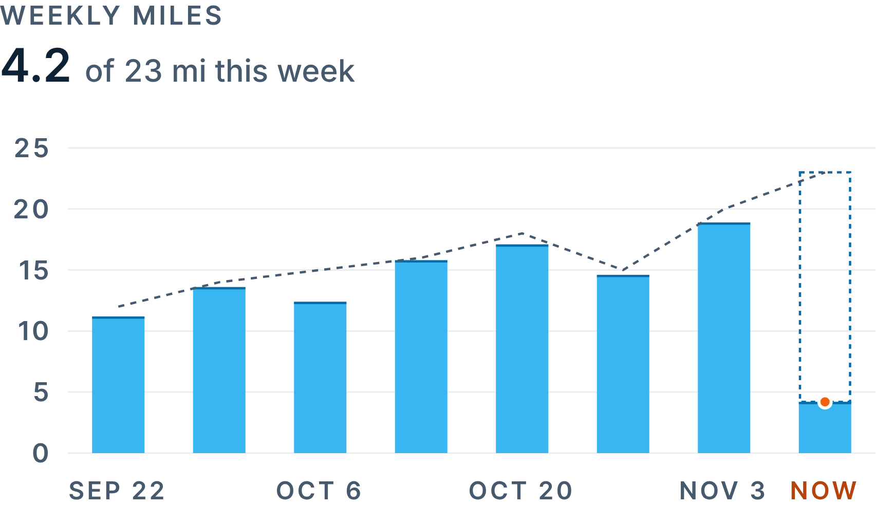
Charts
06 COMPONENTS
Sky bars with a Deep Sky top edge, a dashed plan, one Sunrise now dot, and the headline number printed above.
ACTUAL LINE | 2.5 px Deep Sky; area Sky at 16 percent.
PLAN | 1.5 px Dusk, dashed 4 / 4.
BARS | Done: Sky with a 1.5 px Deep Sky top edge. Planned remainder: 1.5 px Deep Sky dashed 3 / 3.
NOW DOT | 8 px Sunrise, 2 px Paper keyline.
RULER | Haze 6 px, Deep Sky fill, NOW tick 2 x 14 with Ember "NOW", Night Ink plan triangle.
WEEK HORIZON | Half-suns on a --tick line, r = min(20, 6 + 1.5 x mi). Done Sky, planned dashed.
AXES | Caption style, Dusk, tnum. Gridlines --grid. No borders.
Notes:
This week is done plus a dashed planned remainder. Axes are caption style in Dusk with tabular numerals. The headline is Inter 600 with tnum, never Fraunces. On Progress, a week horizon of half-suns sits under the ruler.

Slide 40

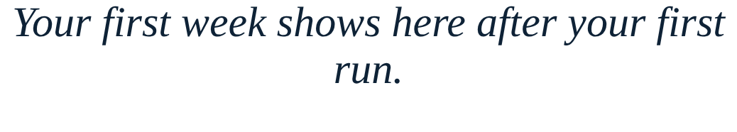
Sheets, toasts and empty states
06 COMPONENTS
Sheets for decisions, toasts for undo, a kind sentence when there is nothing yet.
Easy 5, Tuesday 6:30
Moved your run to Thursday.
Undo
Move to Thursday
Open this week's plan
SHEET
TOAST
EMPTY STATE
Paper, top corners 24, grabber 36 x 5 --grabber, title Fraunces 600, 40 px round buttons, scrim .32, one pinned primary.
Night Ink pill 48 tall, White Inter 15 (16.14), action Haze 600. 3.2 s (5 s with action), never stacks.
Fraunces italic --fs-sentence, one Inter 15 Dusk line, one button. Flat circles only; never the glossy Orb.
Notes:
Sheets open in 500 ms on --ease-sheet; drag releases run on springs.sheet. Toasts are Night Ink pills with White words (16.14). Empty states are a Fraunces italic sentence, one Dusk line and one button.

Slide 41
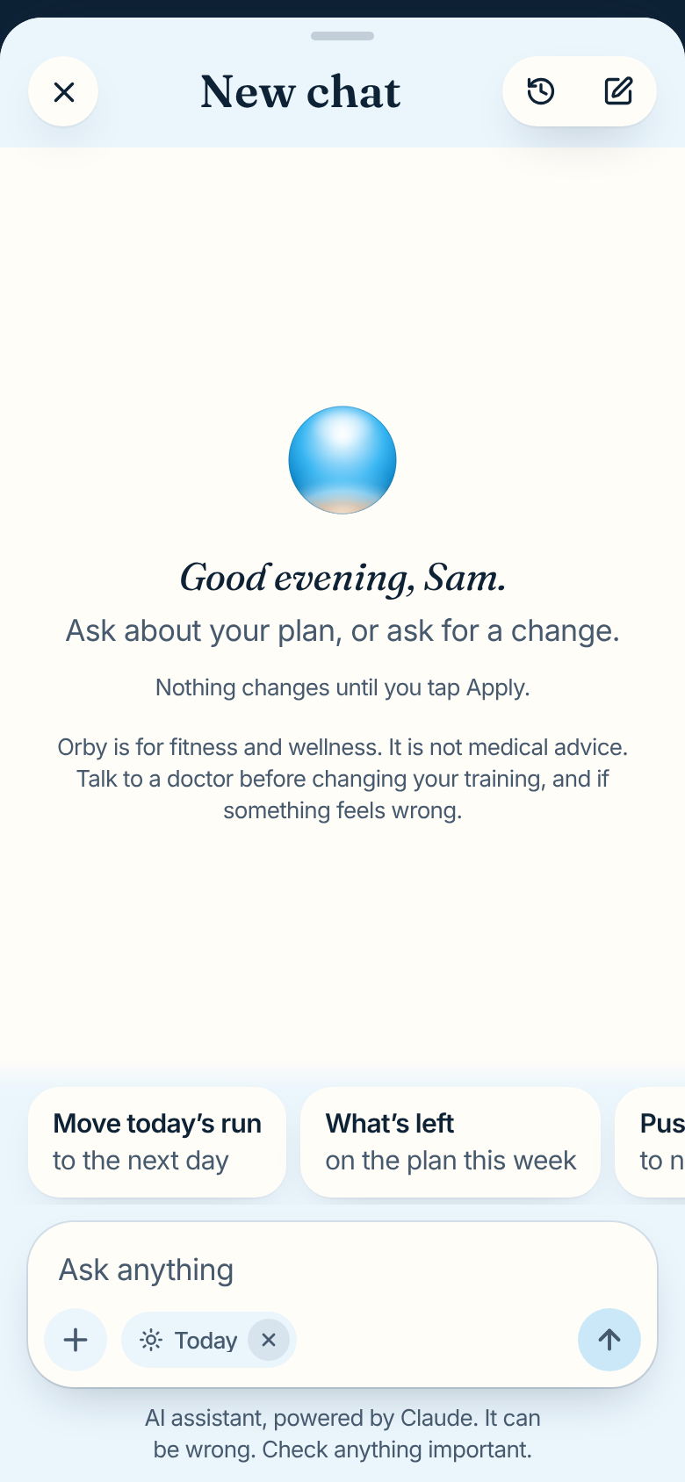
The assistant: composer and working state
06 COMPONENTS
The glossy Orb lives here. It thinks while the assistant works, and a status line says what it is doing.
EMPTY STATE | Orb 56 px with glow. Greeting Fraunces italic --fs-sentence. One Inter 17 Dusk line. Disclaimer --fs-foot.
SUGGESTIONS | Paper cards r 18, --shadow-1, Inter 17 600 and 15 Dusk.
COMPOSER | Paper r 24, 1 px --edge. "Ask anything" Inter 17 Dusk.
SEND | 40 px. Empty Haze; ready Sky with an Ink arrow; working: a 12 px Stop glyph, r 4.
WORKING | Orb thinking. Status Inter 15 Dusk ("Reading your week"), role="status".
DISCLOSURE | The provider line stays exactly as written, --fs-foot Dusk.
THINKING
ARC IS DECORATIVE
Notes:
Call it the assistant, never coach. The thinking arc is decorative; the status line with role="status" is the accessible signal. The provider disclosure stays as compliance wrote it.

Slide 42
Today's other parts, primitives and partner marks
06 COMPONENTS
Every part on Today has a spec (6.13), every primitive has one (6.14), and partner marks follow their owners (6.15).
HOLD RING | Haze track 3 px, Deep Sky fill on stroke-dashoffset over 600 ms. Done: Sky face, Ink check.
MORNING LINE | Data tone line, Paper stops with Ink rings; the live node yields to Night Ink while the gauge pointer shows.
CLOSE THE DAY | Three numbers in Inter 650 tnum (they change).
TO-DOS | Checked: Sky coin, Ink check, Dusk words. User colors are 10 px dots from --tag-*; "orange" renders Ochre.
FIELD | 48 tall, r 14, Paper, 1 px --field-edge (3.20), Inter 17. Error: Signal edge and a line with a glyph.
FOCUS | 1.5 px Deep Sky edge plus 0 0 0 4px rgba(56,182,242,.28).
SWITCH | Sky track on, a check in the thumb so state is not color alone.
SWIPE ACTION | White on Signal (6.45) or White on Deep Sky (5.66).
PARTNER MARKS | Strava and Apple Health art unmodified, own row, never beside a Sunrise mark.
Notes:
Hold ring: Haze track, Deep Sky fill. Focus: a Deep Sky edge plus a 4 px Sky ring at 28%. Strava and Apple Health assets are used as supplied, marked brand-ok: third-party.

Slide 43


Iconography
Circles first, a 1.75 stroke, round caps. Never orange, never emoji.
Notes:
Section 7: grid, stroke, construction, sizes, color and the set.

Slide 44
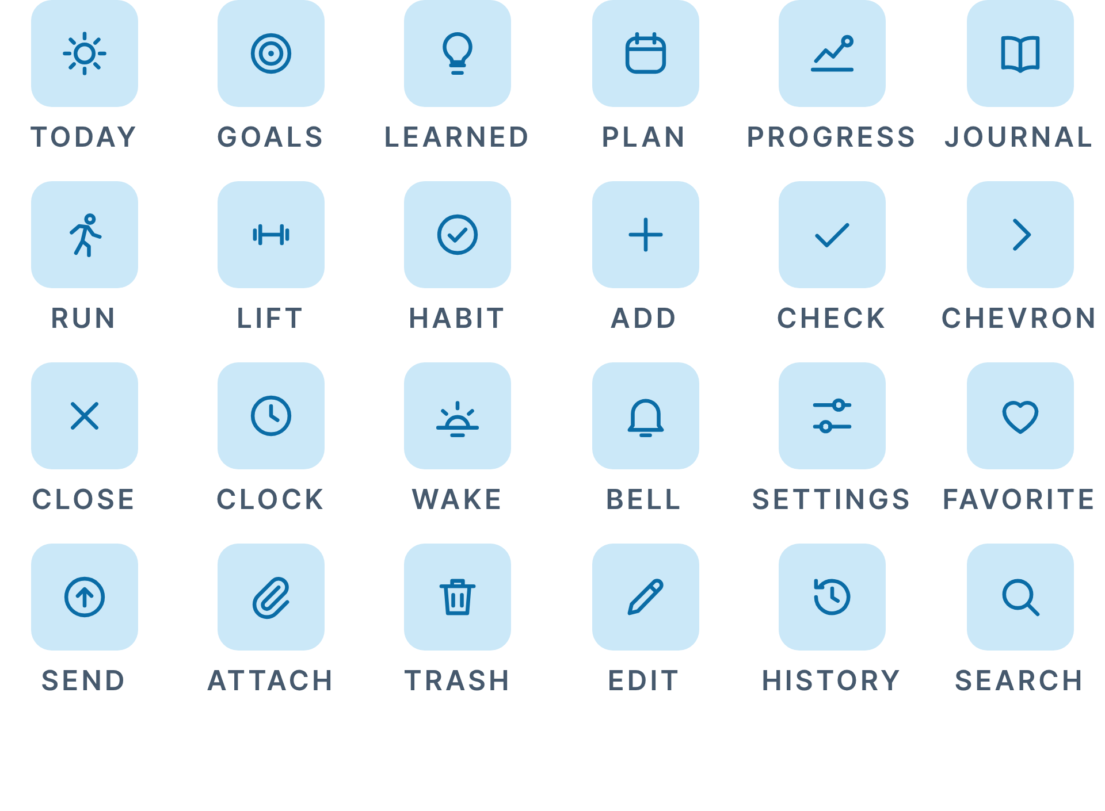
Icons: circles first, 1.75 stroke
07 ICONOGRAPHY
A 24 px grid, round caps and joins, currentColor. Deep Sky in a Haze tile. One Progress glyph everywhere.
GRID | 24 px, 2 px live-area inset.
STROKE | 1.75 px, round caps and joins, currentColor.
CORNERS | Rectangles r 4. One 1.3 px dot is the only fill.
SIZES | 22 in tabs (26 at Larger Text), 18 in buttons, 15 in a 22 tile, 28 on sheets.
COLOR | Dusk inactive, Night Ink active, Deep Sky in a Haze tile, the data tone in a session tile.
NEVER | Emoji, stars, rockets, atoms, filled sets, two styles at once.
Notes:
Today is a sun, Goals concentric rings, Progress a rising line ending in a small circle, in the set, the dock and everywhere else. Lucide fills gaps only at 1.75 with round caps.

Slide 45


Illustration and renders
One glossy object. Flat color everywhere else. The Orb always clears the horizon.
Notes:
Section 8: one render, lighting, the poster, staging, the stamp and the circle vocabulary.

Slide 46
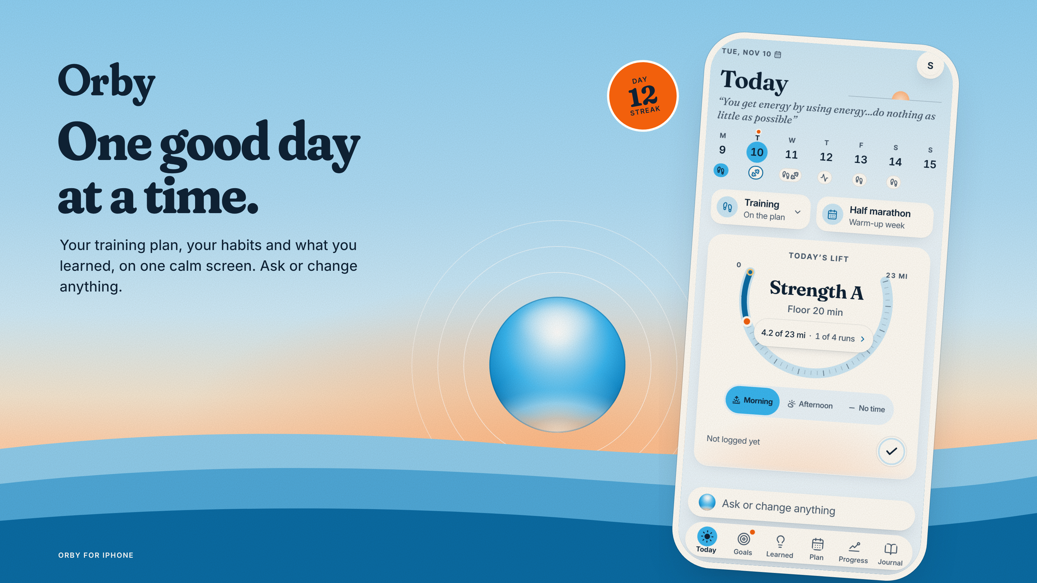
One render, staged the same way every time
08 ILLUSTRATION AND RENDERS
The Orb's bottom clears the horizon by 0.1 D. The horizon glow carries the warmth. Nothing covers the lower half.
ONE RENDER | The Orb only: the assistant, the splash, the app icon.
LIGHTING | Cool white specular from above, Apricot underlight from below.
STAGING | Bottom 0.1 D above the crest; glow on the horizon; lower half never covered.
THE POSTER | Sky #8DD0F5 to #CFEBFA, horizon #F4E6D2 to #FFD2AE, hills #8FCDEE, #4FA9DB, #0A6CA6.
THE STAMP | App: 44 px numeral only, aria-label "Day 12 streak". Art: 92 to 118 px with caption words.
Notes:
Applies to the cover, the app icon, the poster, the landscape hero and the splash. Rings center on the Orb and never cross text. Where the art has its own Orb, use the wordmark alone.

Slide 47


Motion and haptics
Short, soft, and named: transform and opacity, plus three named cases.
Notes:
Section 9: durations, springs, brand moments, Reduce Motion and haptics.

Slide 48
Motion: short, soft and named
09 MOTION AND HAPTICS
Transform and opacity, plus color, background-color and stroke-dashoffset where 9.1 names them. Springs come from lib/motion.ts.
PRESS
160 ms to 0.97, --ease-out
BRAND MOMENTS
COLOR, HALO
200 ms, color or background-color
Splash: the Orb rises 24 px in 900 ms, wordmark fades 200 ms. Dawn wash: overlay opacity, 600 ms, once a day.
FADE IN / OUT
120 / 100 ms
PAGE PUSH
springs.page, 0.35 s
REDUCE MOTION
SHEET OPEN
500 ms, --ease-sheet
150 ms linear fades. The Orb holds still, gauges jump, the splash shows its final frame.
THUMB, REFLOW
springs.settle, 0.30 s
GAUGE FILL
springs.number, stroke-dashoffset
HAPTICS
COMPLETION
springs.complete to 1.12, orb haptic
Named events from lib/haptics.ts, one per action, on the peak frame. Never for navigation.
SPLASH RISE
24 px rise, underlight opacity
Notes:
A gradient never transitions: the dawn wash and the Orb's warming underlight are overlay opacity. The gauge fill uses springs.number, the pointer springs.settle. CSS sheet opens use --ease-sheet; drag releases use springs.sheet.

Slide 49


Voice and copy
Plain, warm, specific, honest. Orby is the product; the assistant speaks.
Notes:
Section 10: principles, glossary and ten lines.

Slide 50
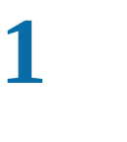
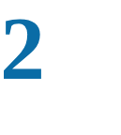
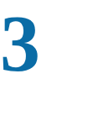
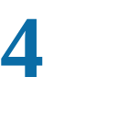
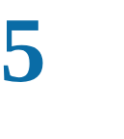
Voice: plain, warm, specific, honest
10 VOICE AND COPY
Orby's copy reads like a friend who runs. Short words, short sentences, numbers instead of adjectives.
Plain
GLOSSARY
Short words, short sentences. One idea per line.
USE | NOT
Orby | the Orby, Orby app, ORBY
the assistant | coach, AI, bot, Orby
entry | post, log
Favorite | star, like, heart
plan | program, schedule
Wake time | alarm, wake-up
session | workout (in UI labels)
habit | streak item, task
Warm, not cute
Encouraging like a friend who runs, never a cheerleader.
Specific
Numbers and times: "Easy 5 at 6:30", not "a great run".
Honest
Say what happened, misses included, without guilt.
House style
American spelling. No em dashes. One exclamation mark at most.
Notes:
American spelling, no em dashes, at most one exclamation mark per screen, no model names in brand copy, sentence case everywhere except captions.

Slide 51
Ten lines, done right and wrong
10 VOICE AND COPY
Copy these patterns. If a new line sounds like the right column, rewrite it.
DO | DON'T
Good morning, Sam. Easy 5 today, then you're free. | Rise and grind, Sam!!! Time to crush it!
Three mornings in a row. Nice work. | AMAZING streak!! You're unstoppable!
Rest day. Your legs will thank you tomorrow. | No workout today :( Don't lose momentum!
What would make today count? | Enter your daily goal below.
Ask or change anything. | Chat with your AI coach.
Moved your run to Thursday. Undo | Your workout has been successfully rescheduled.
You missed Tuesday. Want to fit it in Saturday? | You failed to complete Tuesday's session.
Orby is for fitness and wellness. It is not medical advice. | The Orby app is not a medical device.
4.2 of 23 mi this week | 18% of weekly mileage goal achieved
Nothing written yet. A line or two is plenty. | No entries found.
Notes:
Good copy is plain and specific and never shouts. It names numbers, admits misses kindly, and never calls the assistant a coach.

Slide 52


Accessibility
Every rule has a check. Color is never the only signal.
Notes:
Section 11: contrast, color alone, Dynamic Type, targets, Reduce Motion, Increase Contrast, VoiceOver.

Slide 53
Accessibility is part of the brand
11 ACCESSIBILITY
Test at 200 percent text with Reduce Motion and Increase Contrast on.
Contrast
Color alone
Dynamic Type
Targets
Body 4.5:1, large 3:1, graphics 3:1. check-contrast.mjs reads tokens.json.
Disc plus numeral, coin plus check, dot plus Ink letter, printed readouts.
rem sizes with 11, 12, 13 px floors. Nothing clips at 200 percent.
44 x 44 pt for anything tappable, week cells and chips included.
Reduce Motion
Increase Contrast
VoiceOver
Status
Every move a 150 ms linear fade. The Orb holds still.
Dusk to #33475B, Deep Sky to #085A8C, Pencil to #5F6D7B, aliases and palette names.
The Orb reads "Assistant" or "Orby". Gauges read their readout. Stamps "Day 12 streak".
The thinking arc and skeletons pair with role="status" text.
Notes:
Body 4.5:1, large text and meaningful graphics 3:1. Increase Contrast remaps both semantic aliases and palette names. Animated working indicators carry a status line.

Slide 54


Applying it to the app
Same structure, new palette, type and shape. Every screen has a mockup.
Notes:
Section 12: screen by screen, the token migration and the order for builders.

Slide 55
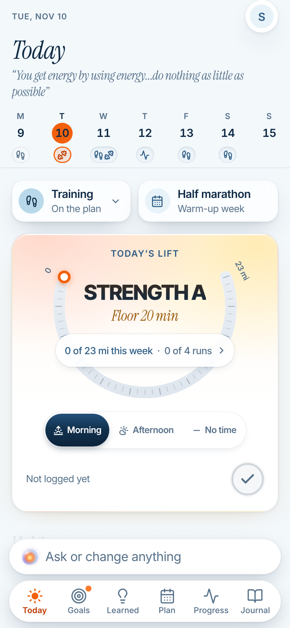
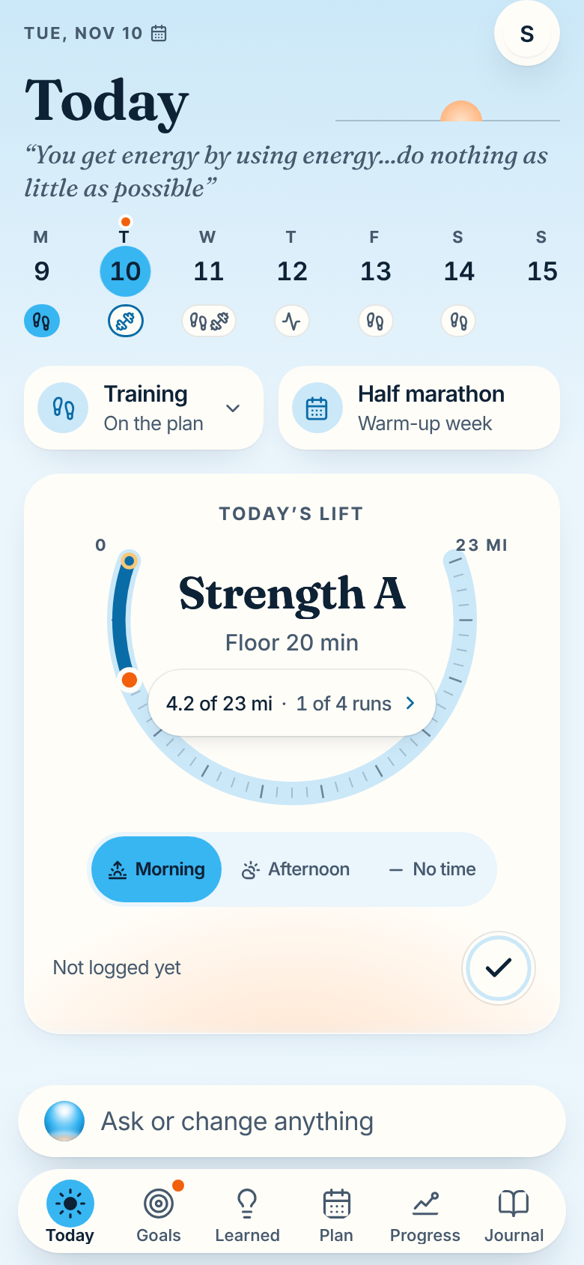
Today, before and after
12 APPLYING IT TO THE APP
Same screen, same structure. Sky leads, orange only marks now, and a half-sun sits on the title line.
GROUND | Dawn wash on Cloud; the title-line sunrise.
WEEK STRIP | Sky disc for the shown day; today keeps its dot.
HERO CARD | Paper and the glow. Deep Sky fill, Sunrise pointer, horizontal ends, readout in the bowl.
SESSION | "Strength A" in Fraunces title case.
CONTROLS | Sky thumb with Ink words.
DOCK | 28 px gloss Orb, Sky active disc.
BEFORE
AFTER
Notes:
The navy pill becomes a Sky pill with Ink words, the orange selected day becomes a Sky disc with today's Sunrise dot kept apart, caps become Fraunces title case.

Slide 56
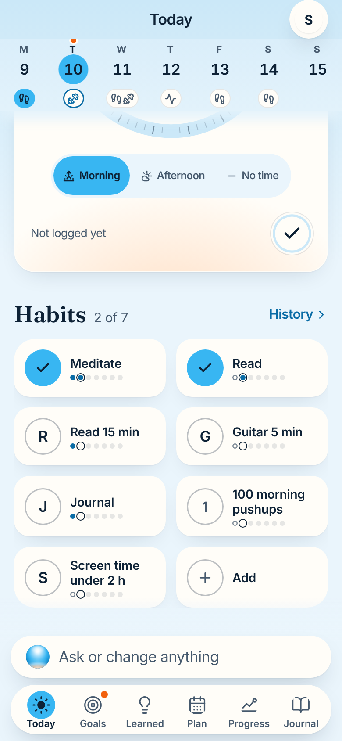
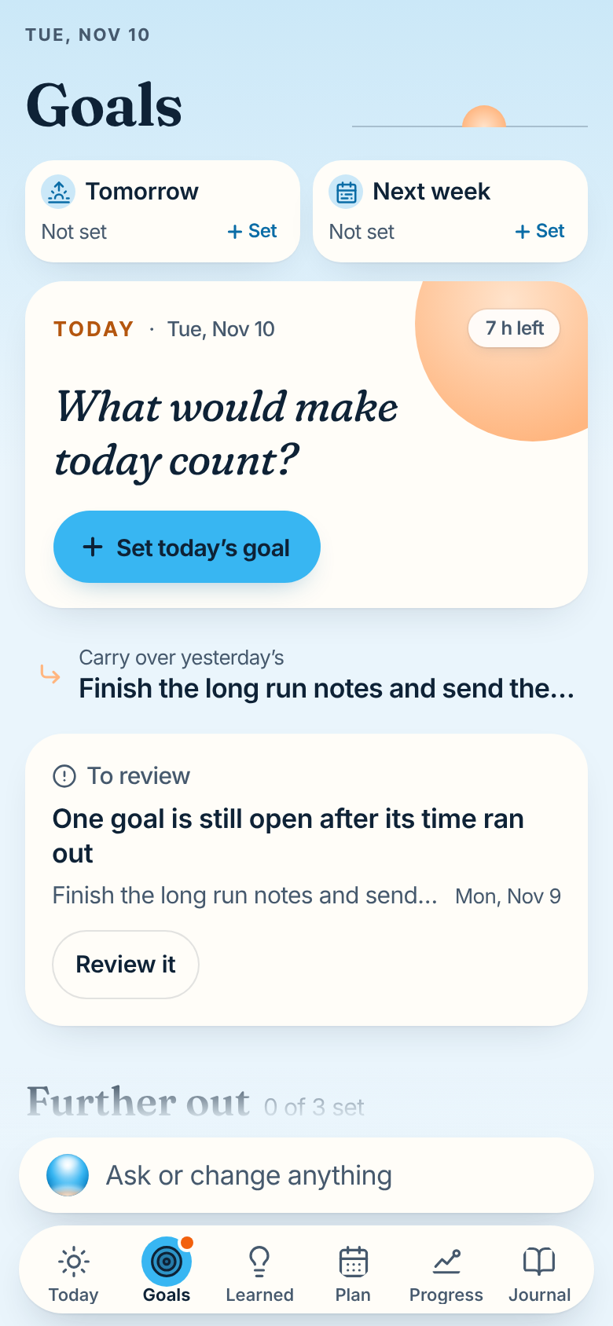
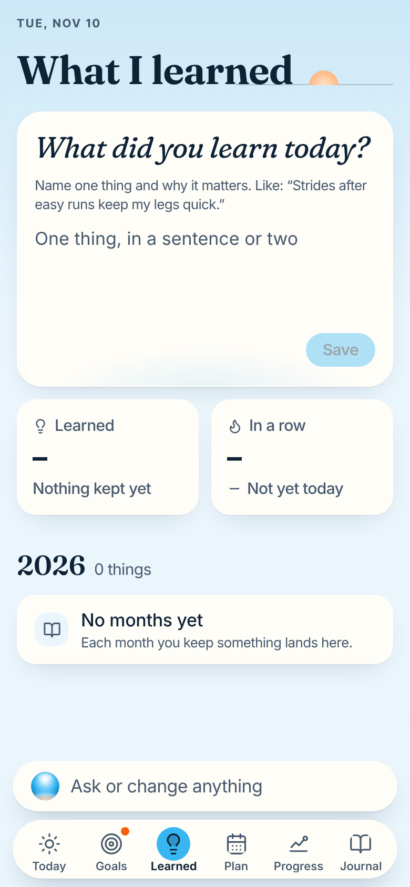
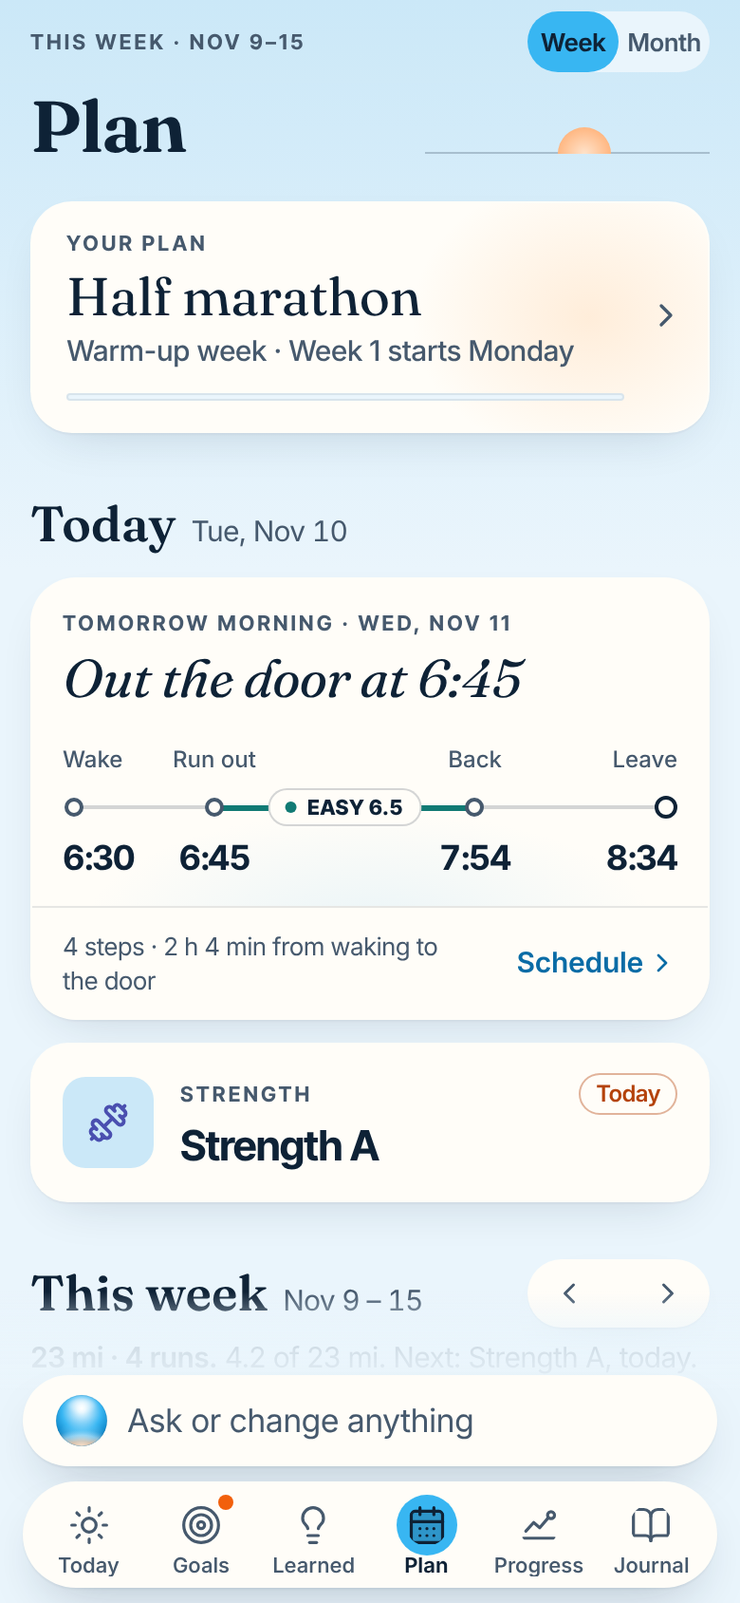
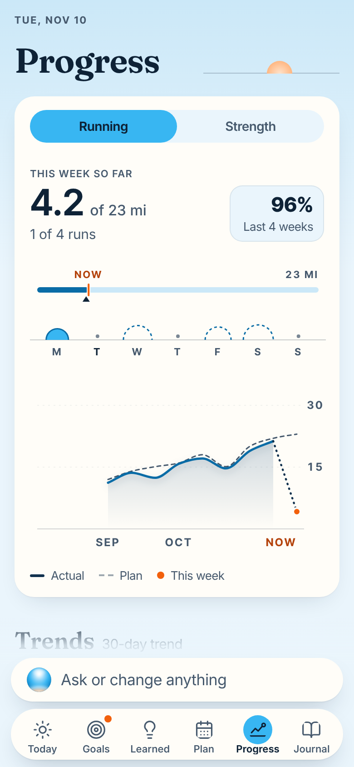
Applied: Today, Goals, Learned, Plan, Progress
12 APPLYING IT TO THE APP
The live app at 390 x 844 with the new tokens, seeded with a week of runs.
TODAY, HABITS
GOALS
LEARNED
PLAN
PROGRESS
Two lit Sky coins
One primary, quiet "+ Set"
Input in Inter 17
Sunrise live node
Ruler, half-suns, now dot
Notes:
Each screen keeps its structure. The Progress week horizon is the proposed component from 6.8, drawn by the shoot script. override.css lists the class-level changes tokens cannot reach.

Slide 57
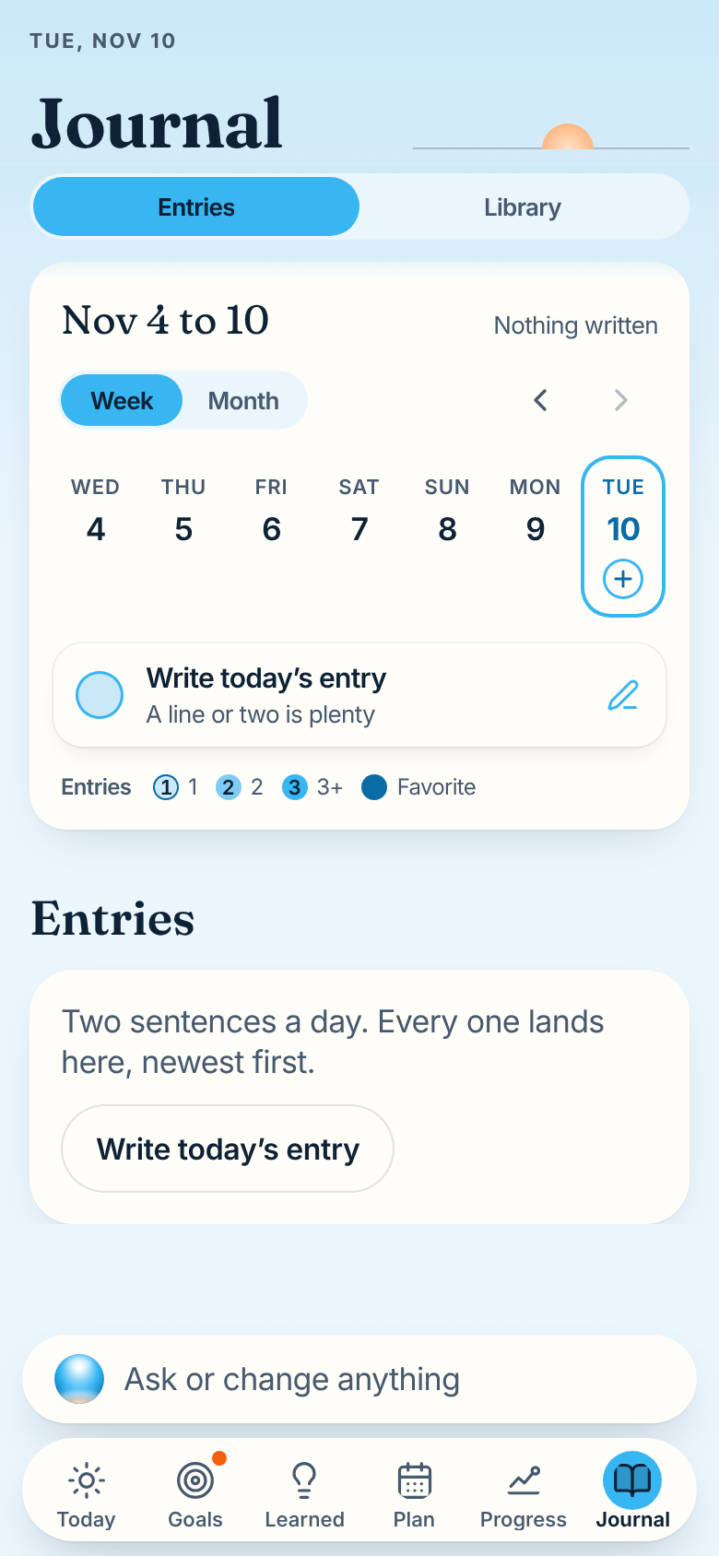



Applied: Journal, the assistant, Settings, welcome, splash
12 APPLYING IT TO THE APP
The splash is the one place the Orb rises: over the poster's hills, with a caption that follows the time of day.
JOURNAL
THE ASSISTANT
SETTINGS
WELCOME
SPLASH
Flat discs with numerals
Orb 56 px, Fraunces greeting
Inset groups, Haze tiles
Outlined lockup
GOOD MORNING, AFTERNOON, EVENING
Notes:
Native splash: the still Orb centered on Cloud. theme-color and backgroundColor become #EAF5FC.

Slide 58


The checklist and the brand agent
A change is done when every line is true, checked by the brand-guardian agent.
Notes:
Section 13 and 13.1.

Slide 59
Before you finish any UI change
13 THE CHECKLIST
Run all of it. Lines marked runtime need the app running; a rule that was not run is unverified, never passed.
Every value from a token. check-brand.mjs adds no findings.
Radii 24, 18, 14, 12, pill, circle. Spacing on steps or a named exception.
Every pairing listed (3.2). pnpm test passes. Runtime: the audit.
Captions: Inter Tight 600, caps, +0.14 em, one per card.
No Sky text on light, no white on Sky, no Sunrise text.
Icons 1.75, round caps, the set's Progress glyph. No emoji.
At most 3 Sunrise marks, by priority; keylines 2 px or more. Runtime.
Copy: Orby, the assistant, American spelling, no em dashes.
One Orb, sized by tier: 48+, 28 to 47, under 28 flat. Runtime.
Tested at 200 percent, Reduce Motion, Increase Contrast. Runtime.
One hero card and one glow. Runtime.
Motion: transform, opacity and the named cases only.
Fraunces only in titles, sentences, static stats. No stray axes.
Partner marks unmodified, marked brand-ok: third-party.
Live numbers are Inter with tnum. Gauges print a readout.
Identifiers unchanged. A screenshot matches its mockup.
Notes:
The definition of done. check-brand.mjs covers the static lines; docs/brand/tools/audit.mjs covers the runtime ones.

Slide 60




The brand agent: the guide, as a reviewer
13.1 THE BRAND AGENT
The brand-guardian agent (.claude/agents/brand-guardian.md) checks every change against the guide and the tokens.
Ask before you build
Run it on your diff
Give it a URL
Fix and re-run
"Which tokens does a new filter chip use?" It answers with values and the guide section.
check-brand.mjs: colors, fonts, sizes, radii, tracking, spacing, motion, axes and copy.
audit.mjs checks pairings on real grounds, the Sunrise count, Orbs, sizes and tnum.
PASS needs every line; anything not run is listed as not verified.
WHAT IT READS AND RUNS
WHAT IT NEVER DOES
brand-guide.md, tokens.css, tokens.json and the diff. check-brand.mjs, check-styles.mjs, check-contrast.mjs when tokens change, and audit.mjs on the screens touched.
Edit files, invent a token, approve an unlisted pairing, rename the repo, packages, bundle id or storage keys, or pass a rule it could not check.
Notes:
It reads the guide, tokens.css and tokens.json and the diff across apps/web, apps/api, packages/shared and the shell files. It runs check-brand, check-styles and, with a dev server URL, the runtime audit. It never edits files.

Slide 61

One good day at a time.
QUESTIONS GO TO DOCS/BRAND/BRAND-GUIDE.MD. WHEN THE GUIDE IS SILENT, ASK BEFORE INVENTING.
Notes:
The guide is the source of truth; this deck is its summary. If they disagree, the guide wins, and someone fixes the deck.

